Slide 1

Wildcat Valley Railway
Control Systems Nov 2020

Slide 2

JMRI IMPLEMENTATION ON THE WVR
Control turnouts from JMRI panels, facia panels, throttles
Display block occupancy on JMRI control panels
Control the track signal system based on block occupancy using JMRI
Control layout lighting using JMRI and DMX512

Slide 3
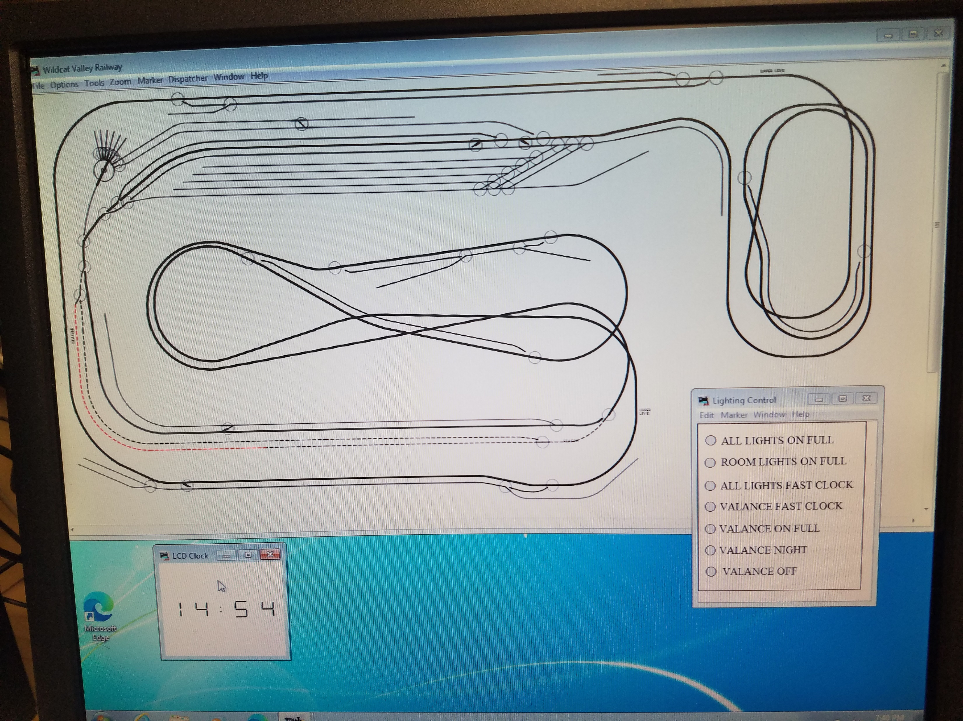
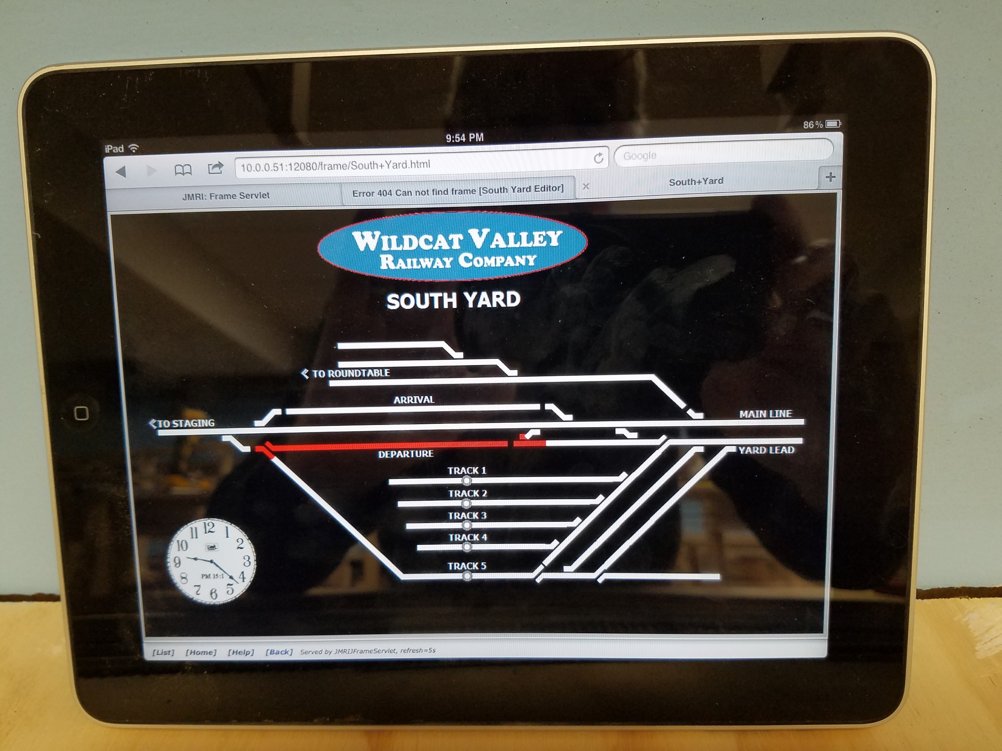
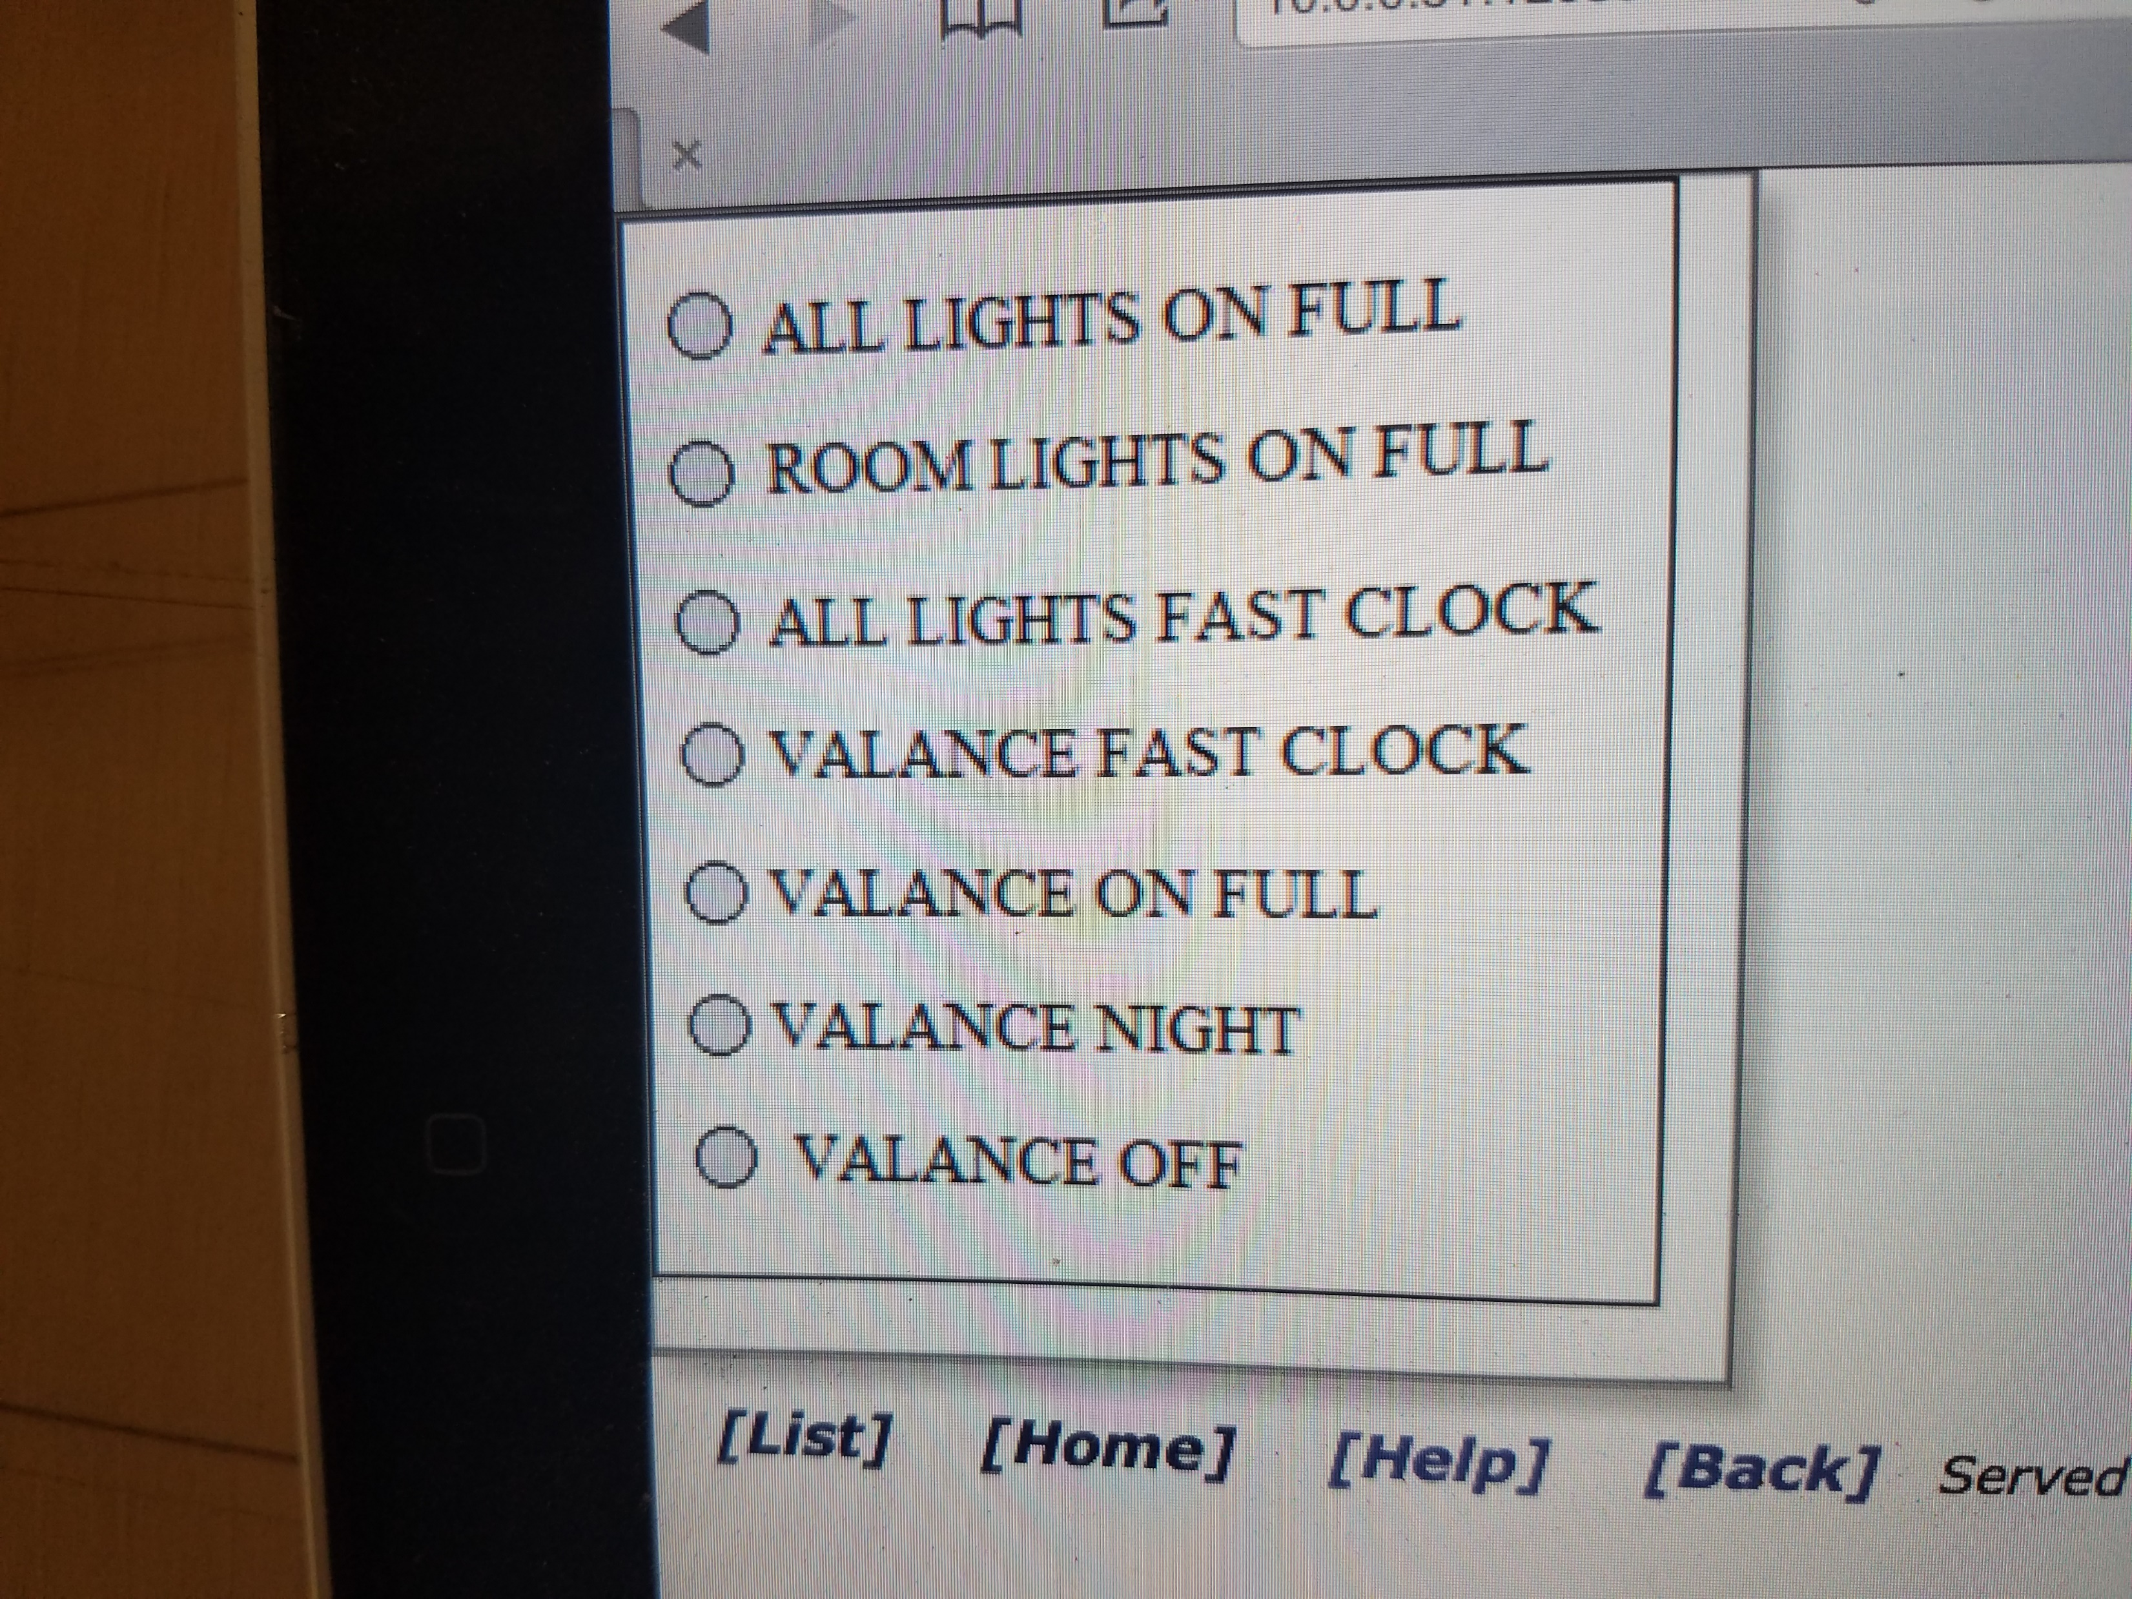

Slide 4


Slide 5
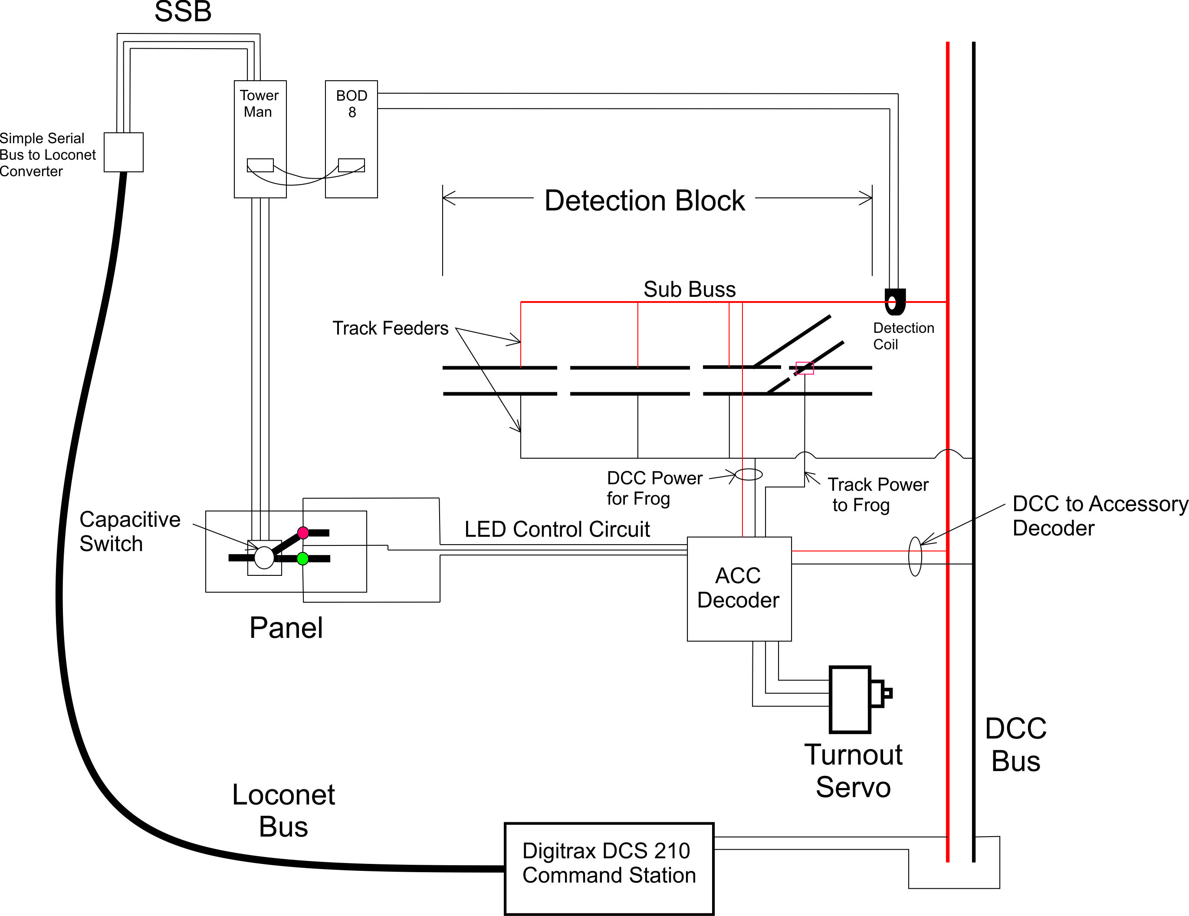
Overview of Block Detection and Turnout Control
This was my initial setup used to test the systems for viability. I am still using the RR-CirKits Tower Man board, but I have also installed a Tower Controller Mark II which interfaces directly to the Loconet bus. The Tower Man and TC Mark II are programmed using the JMRI Decoder Pro program.

Slide 6
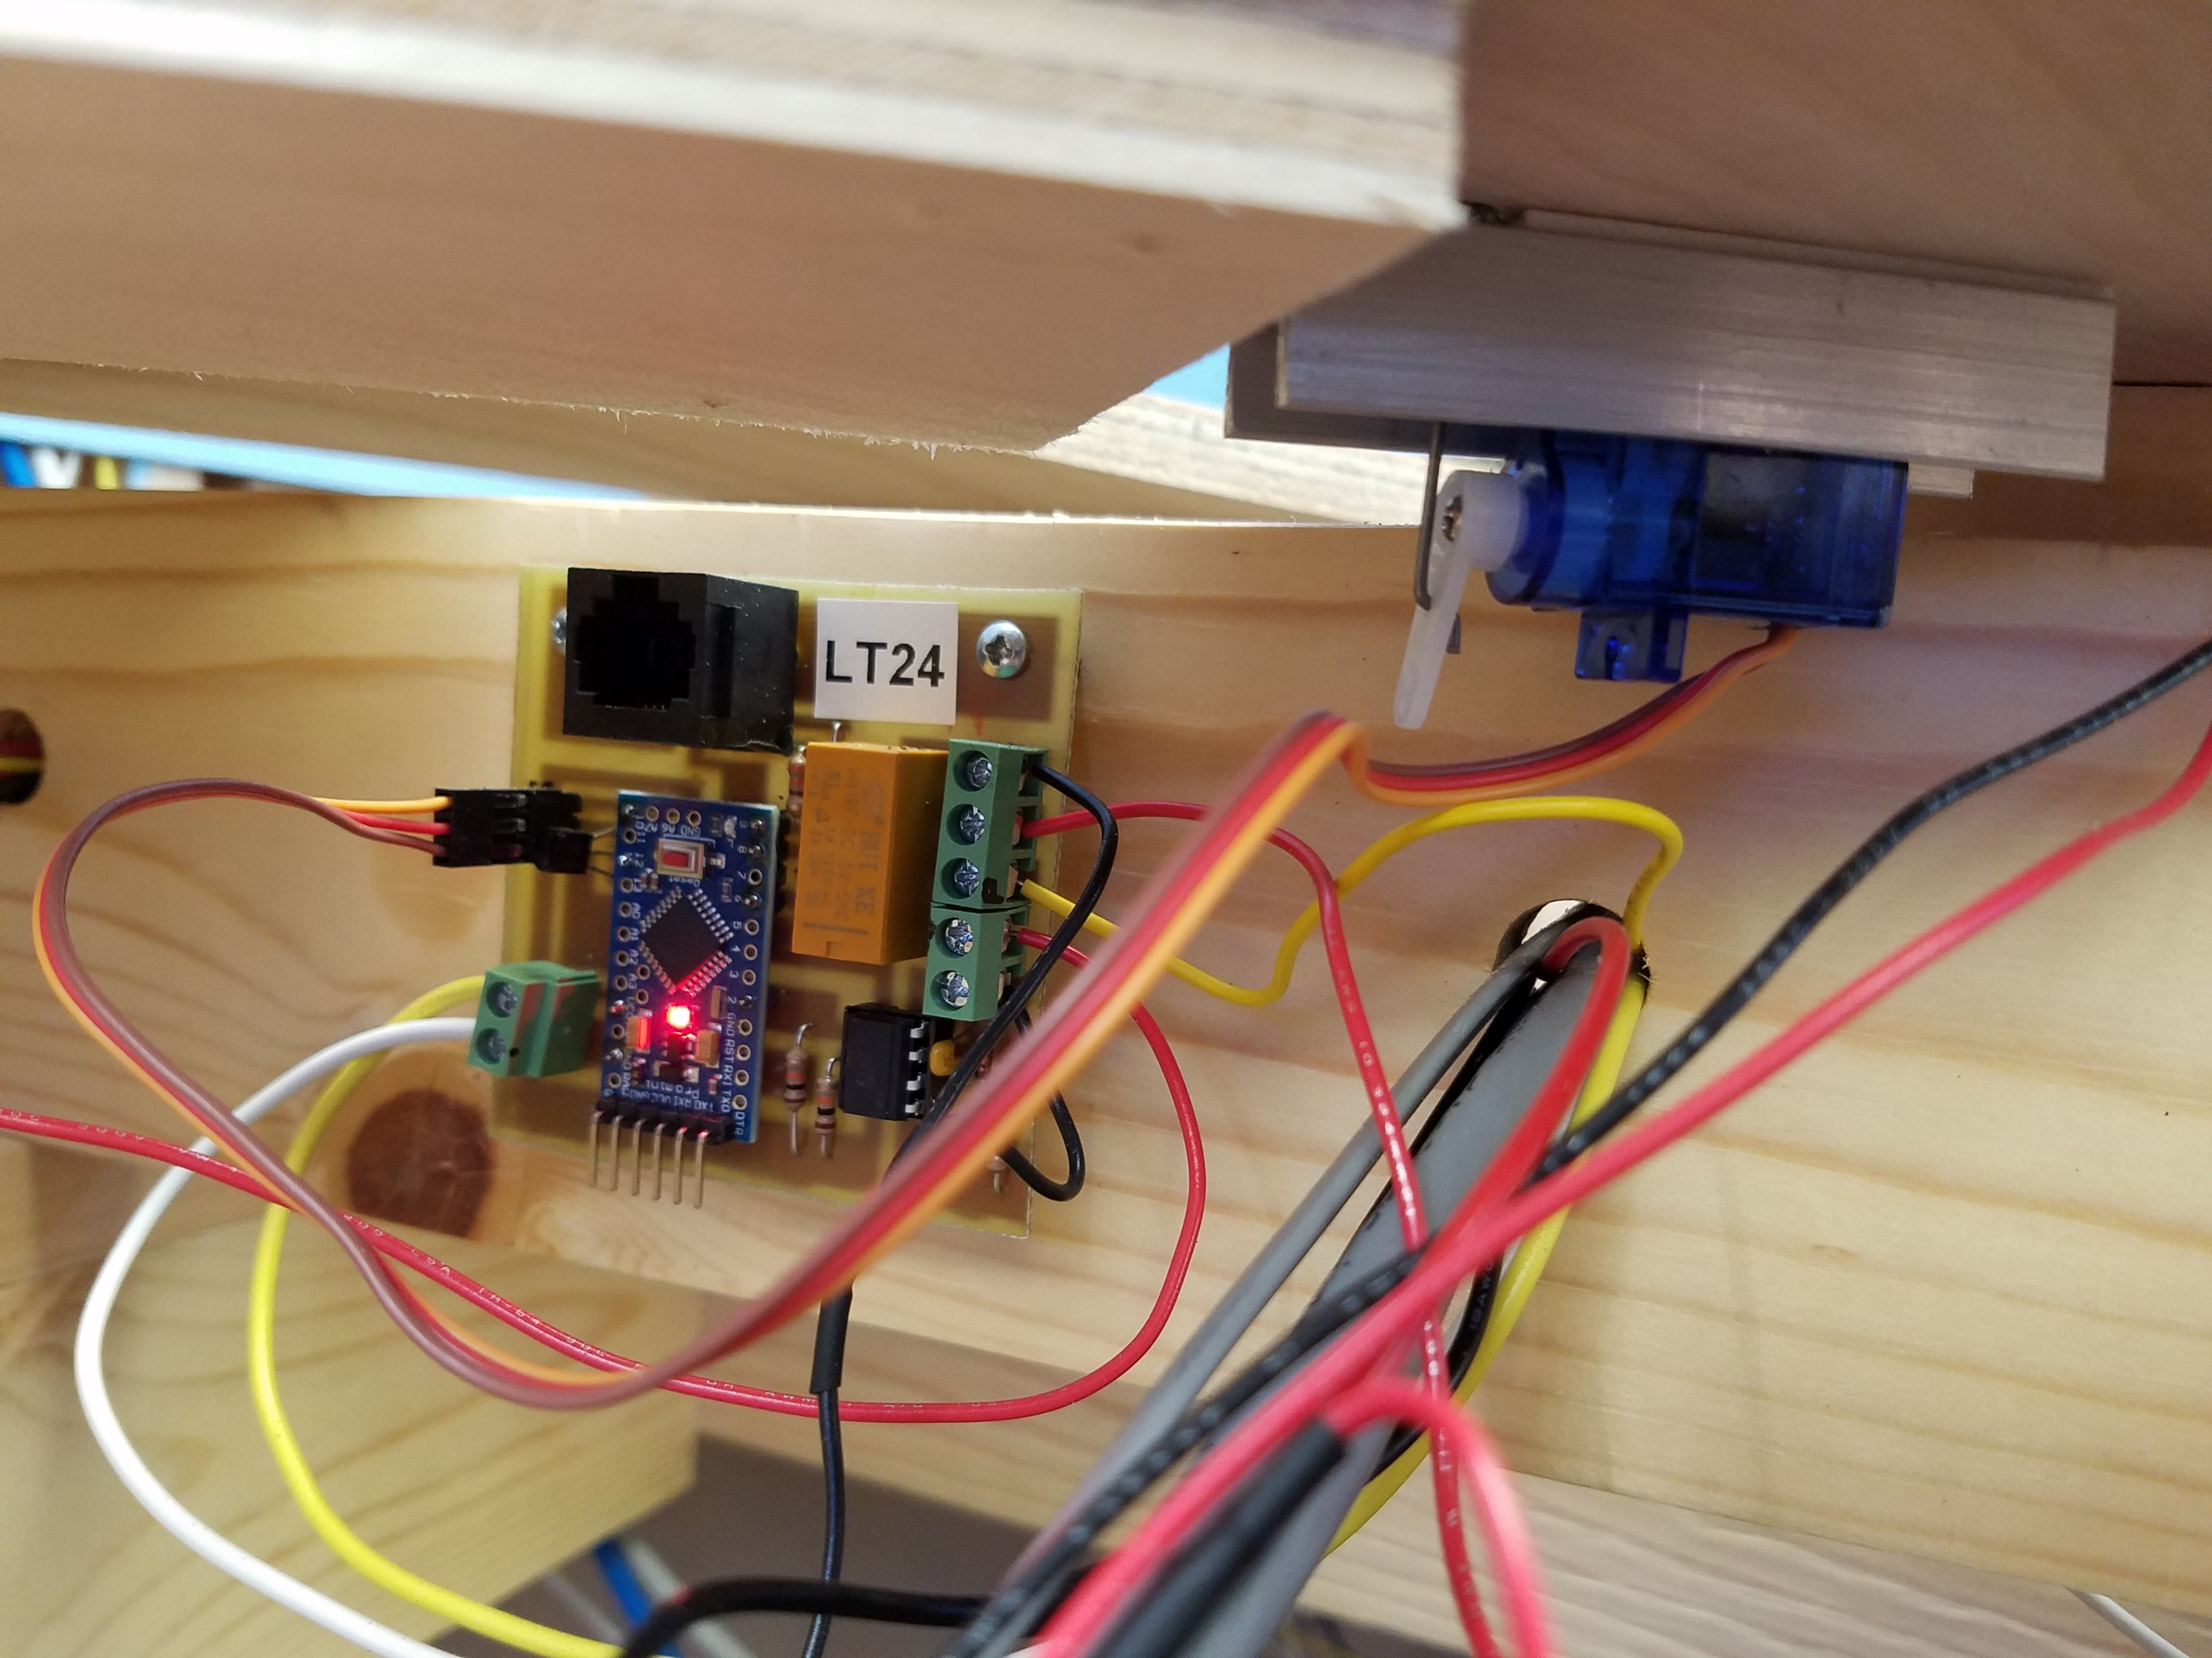

Slide 7
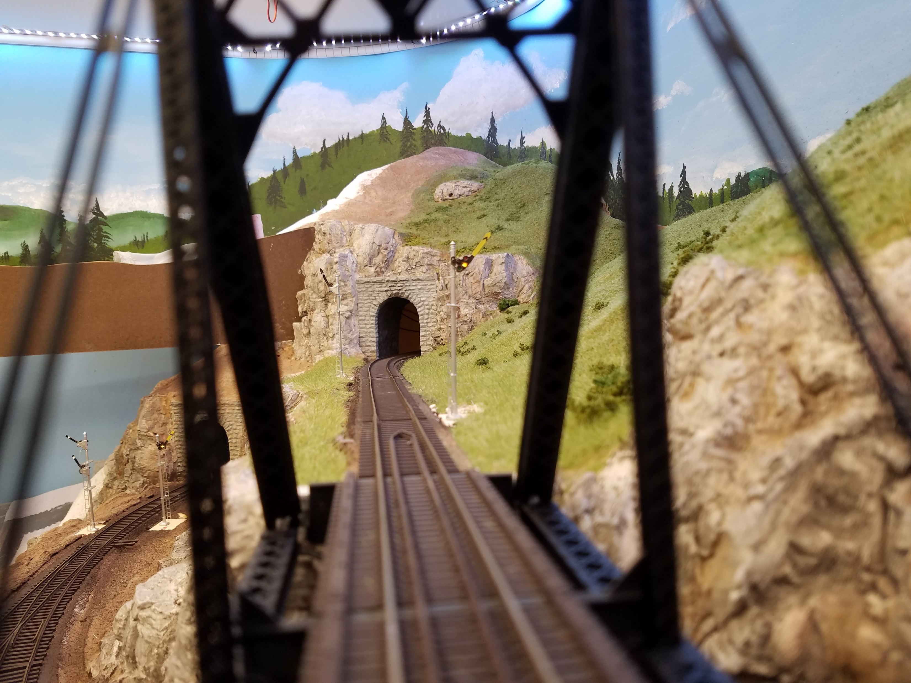
Semaphores respond to turnout commands from JMRI to set the aspect

Slide 8
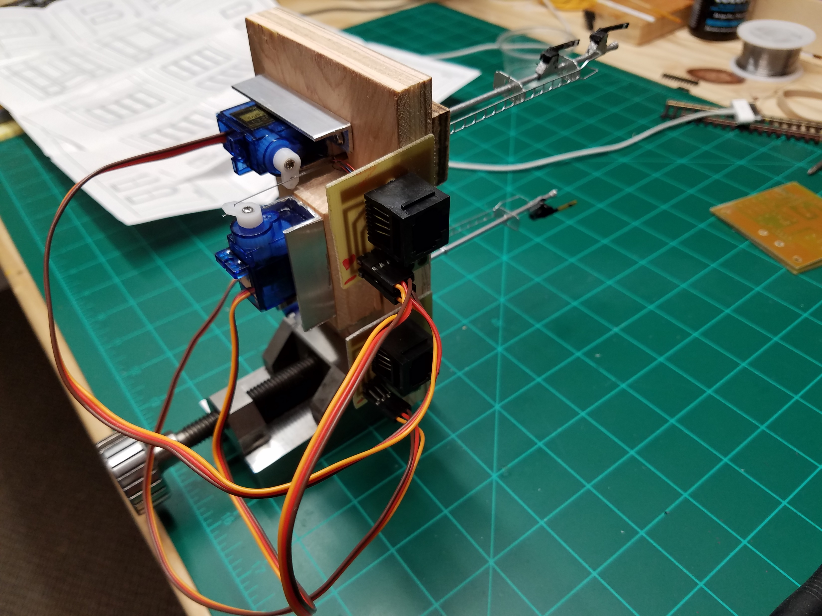
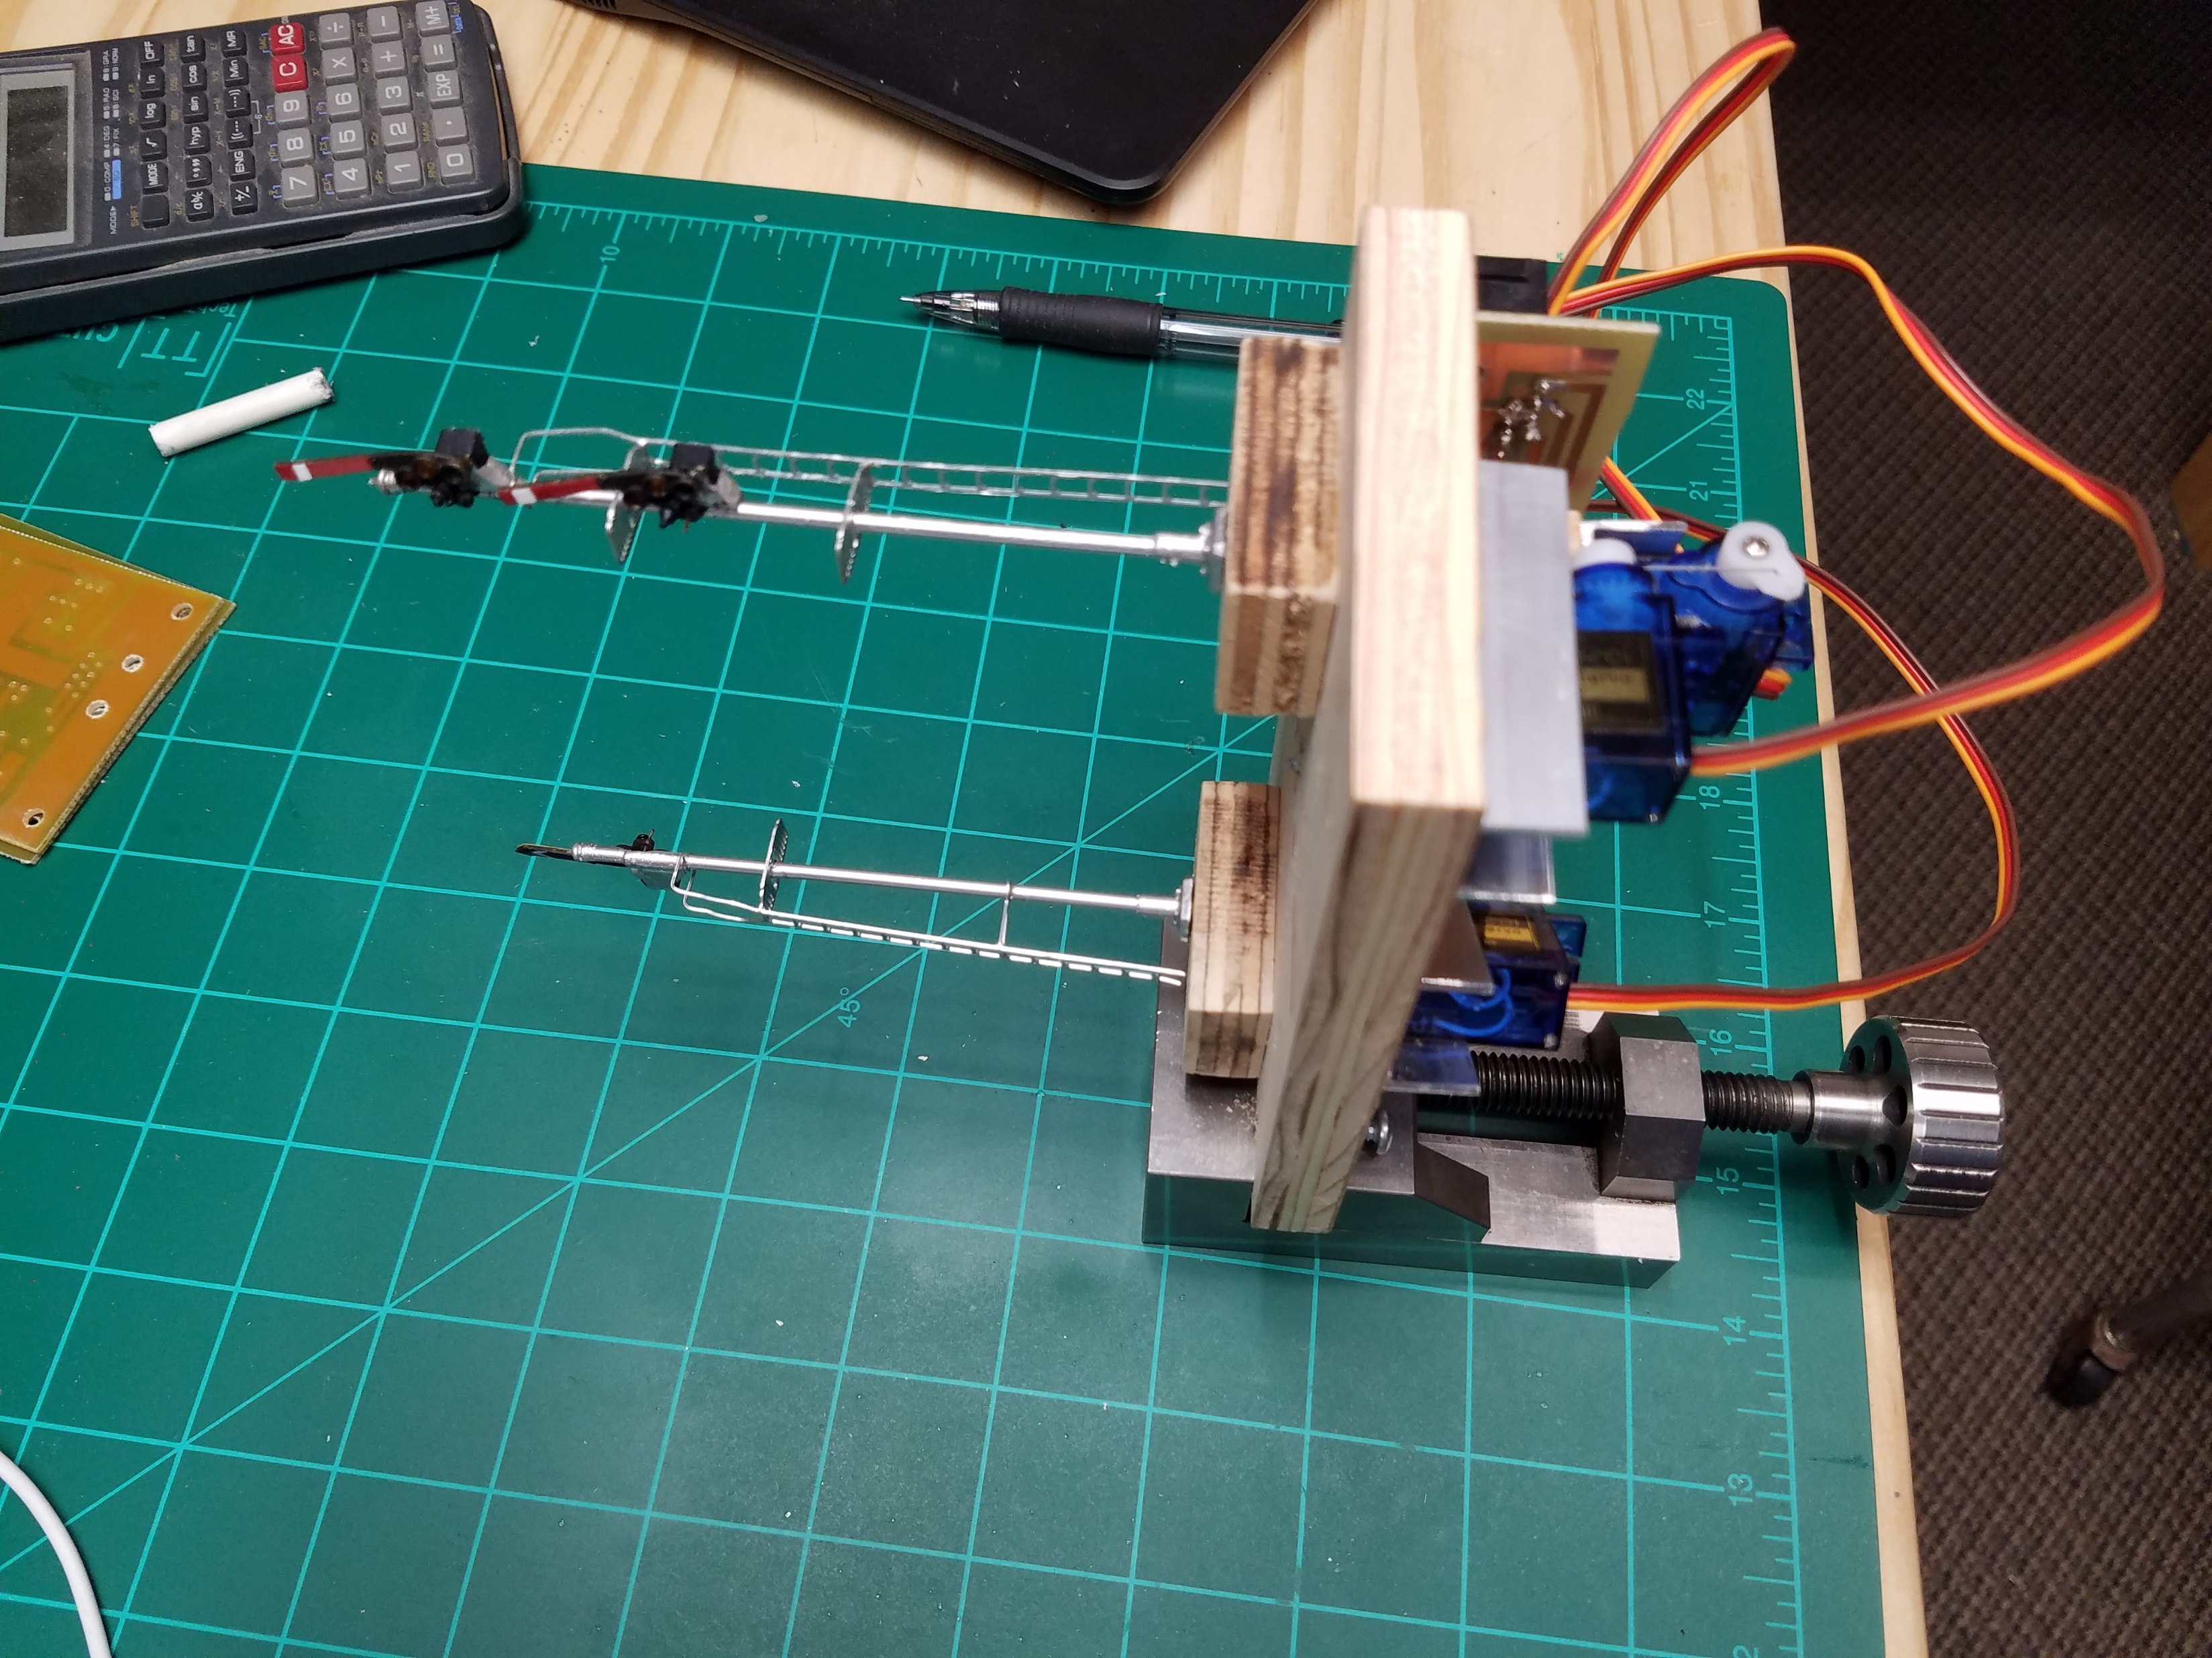
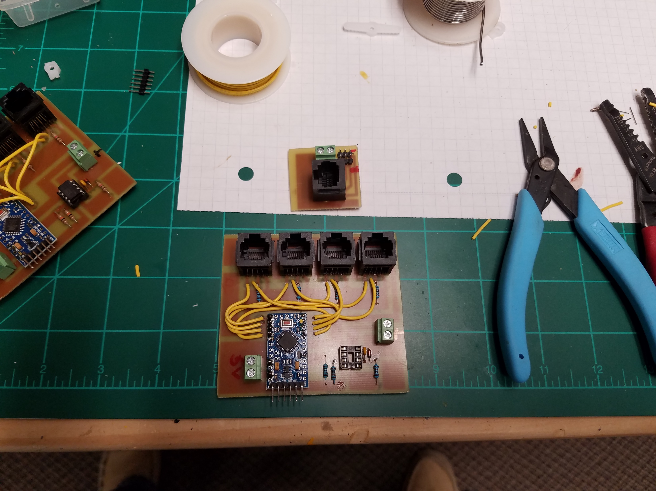

Slide 9
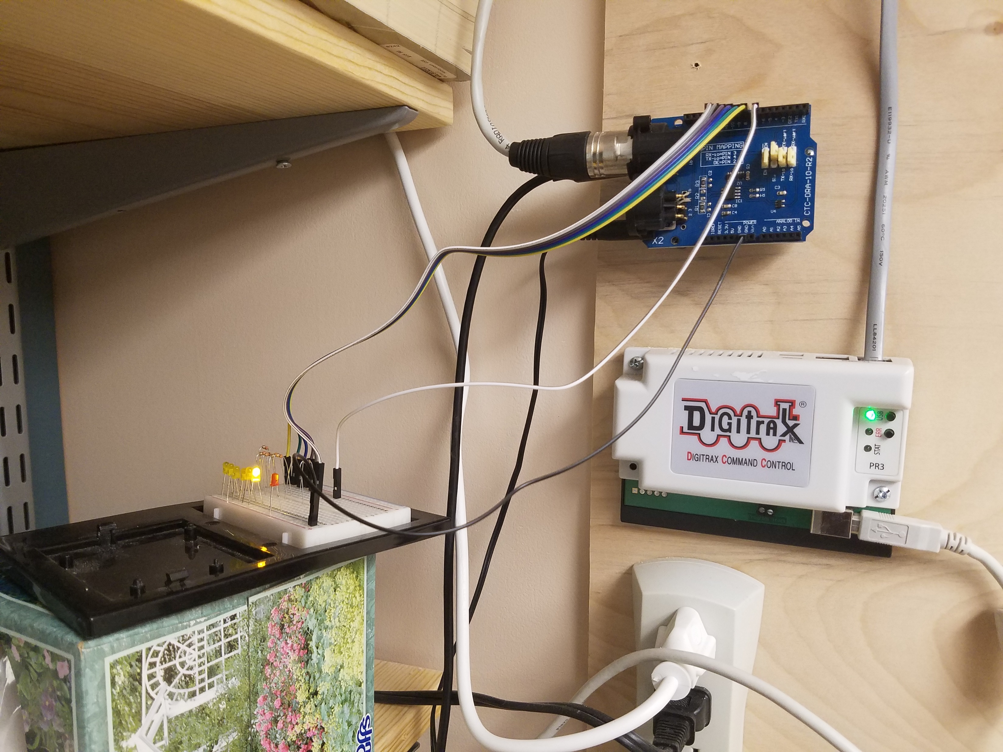
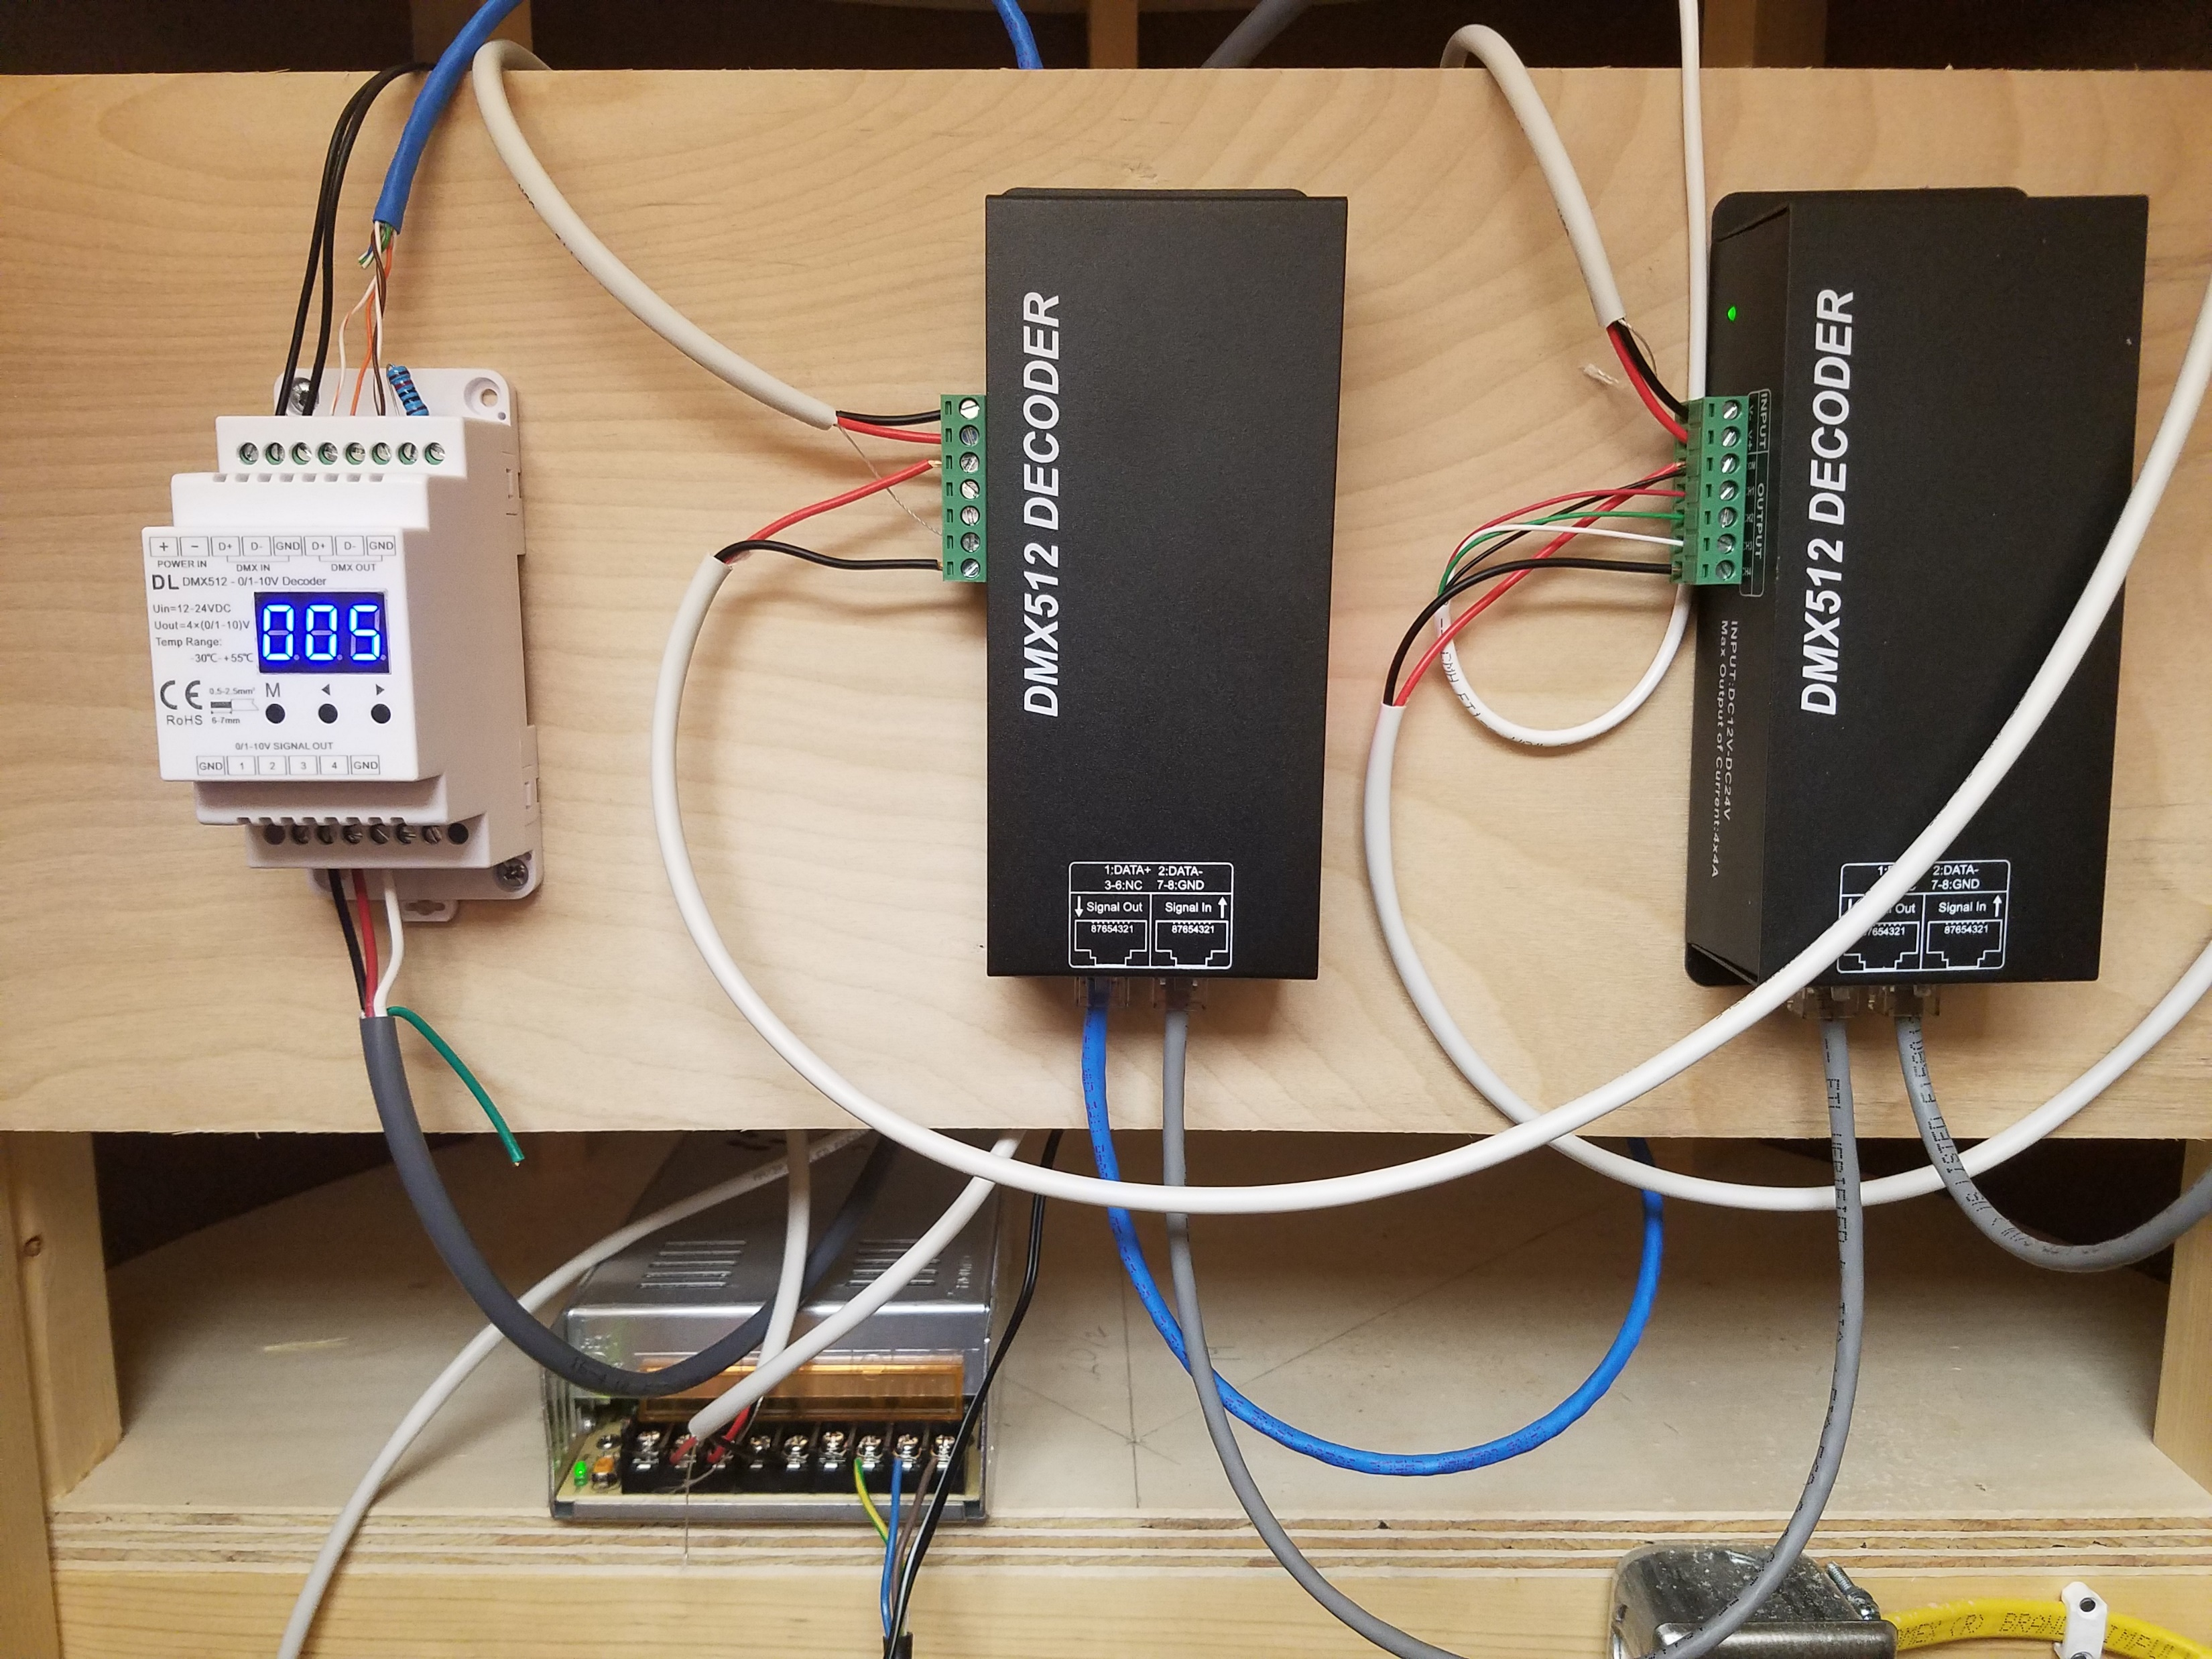
DMX 512 lighting control for LED strip lights
Ethernet cables carry the dmx 512 signals to the receivers around the room which control the LED strips brightness.
The Arduino with DMX shield receives turnout signals from the JMRI computer generated based on the JMRI fast clock. Additional turnout commands are used to change the mode.

Slide 10
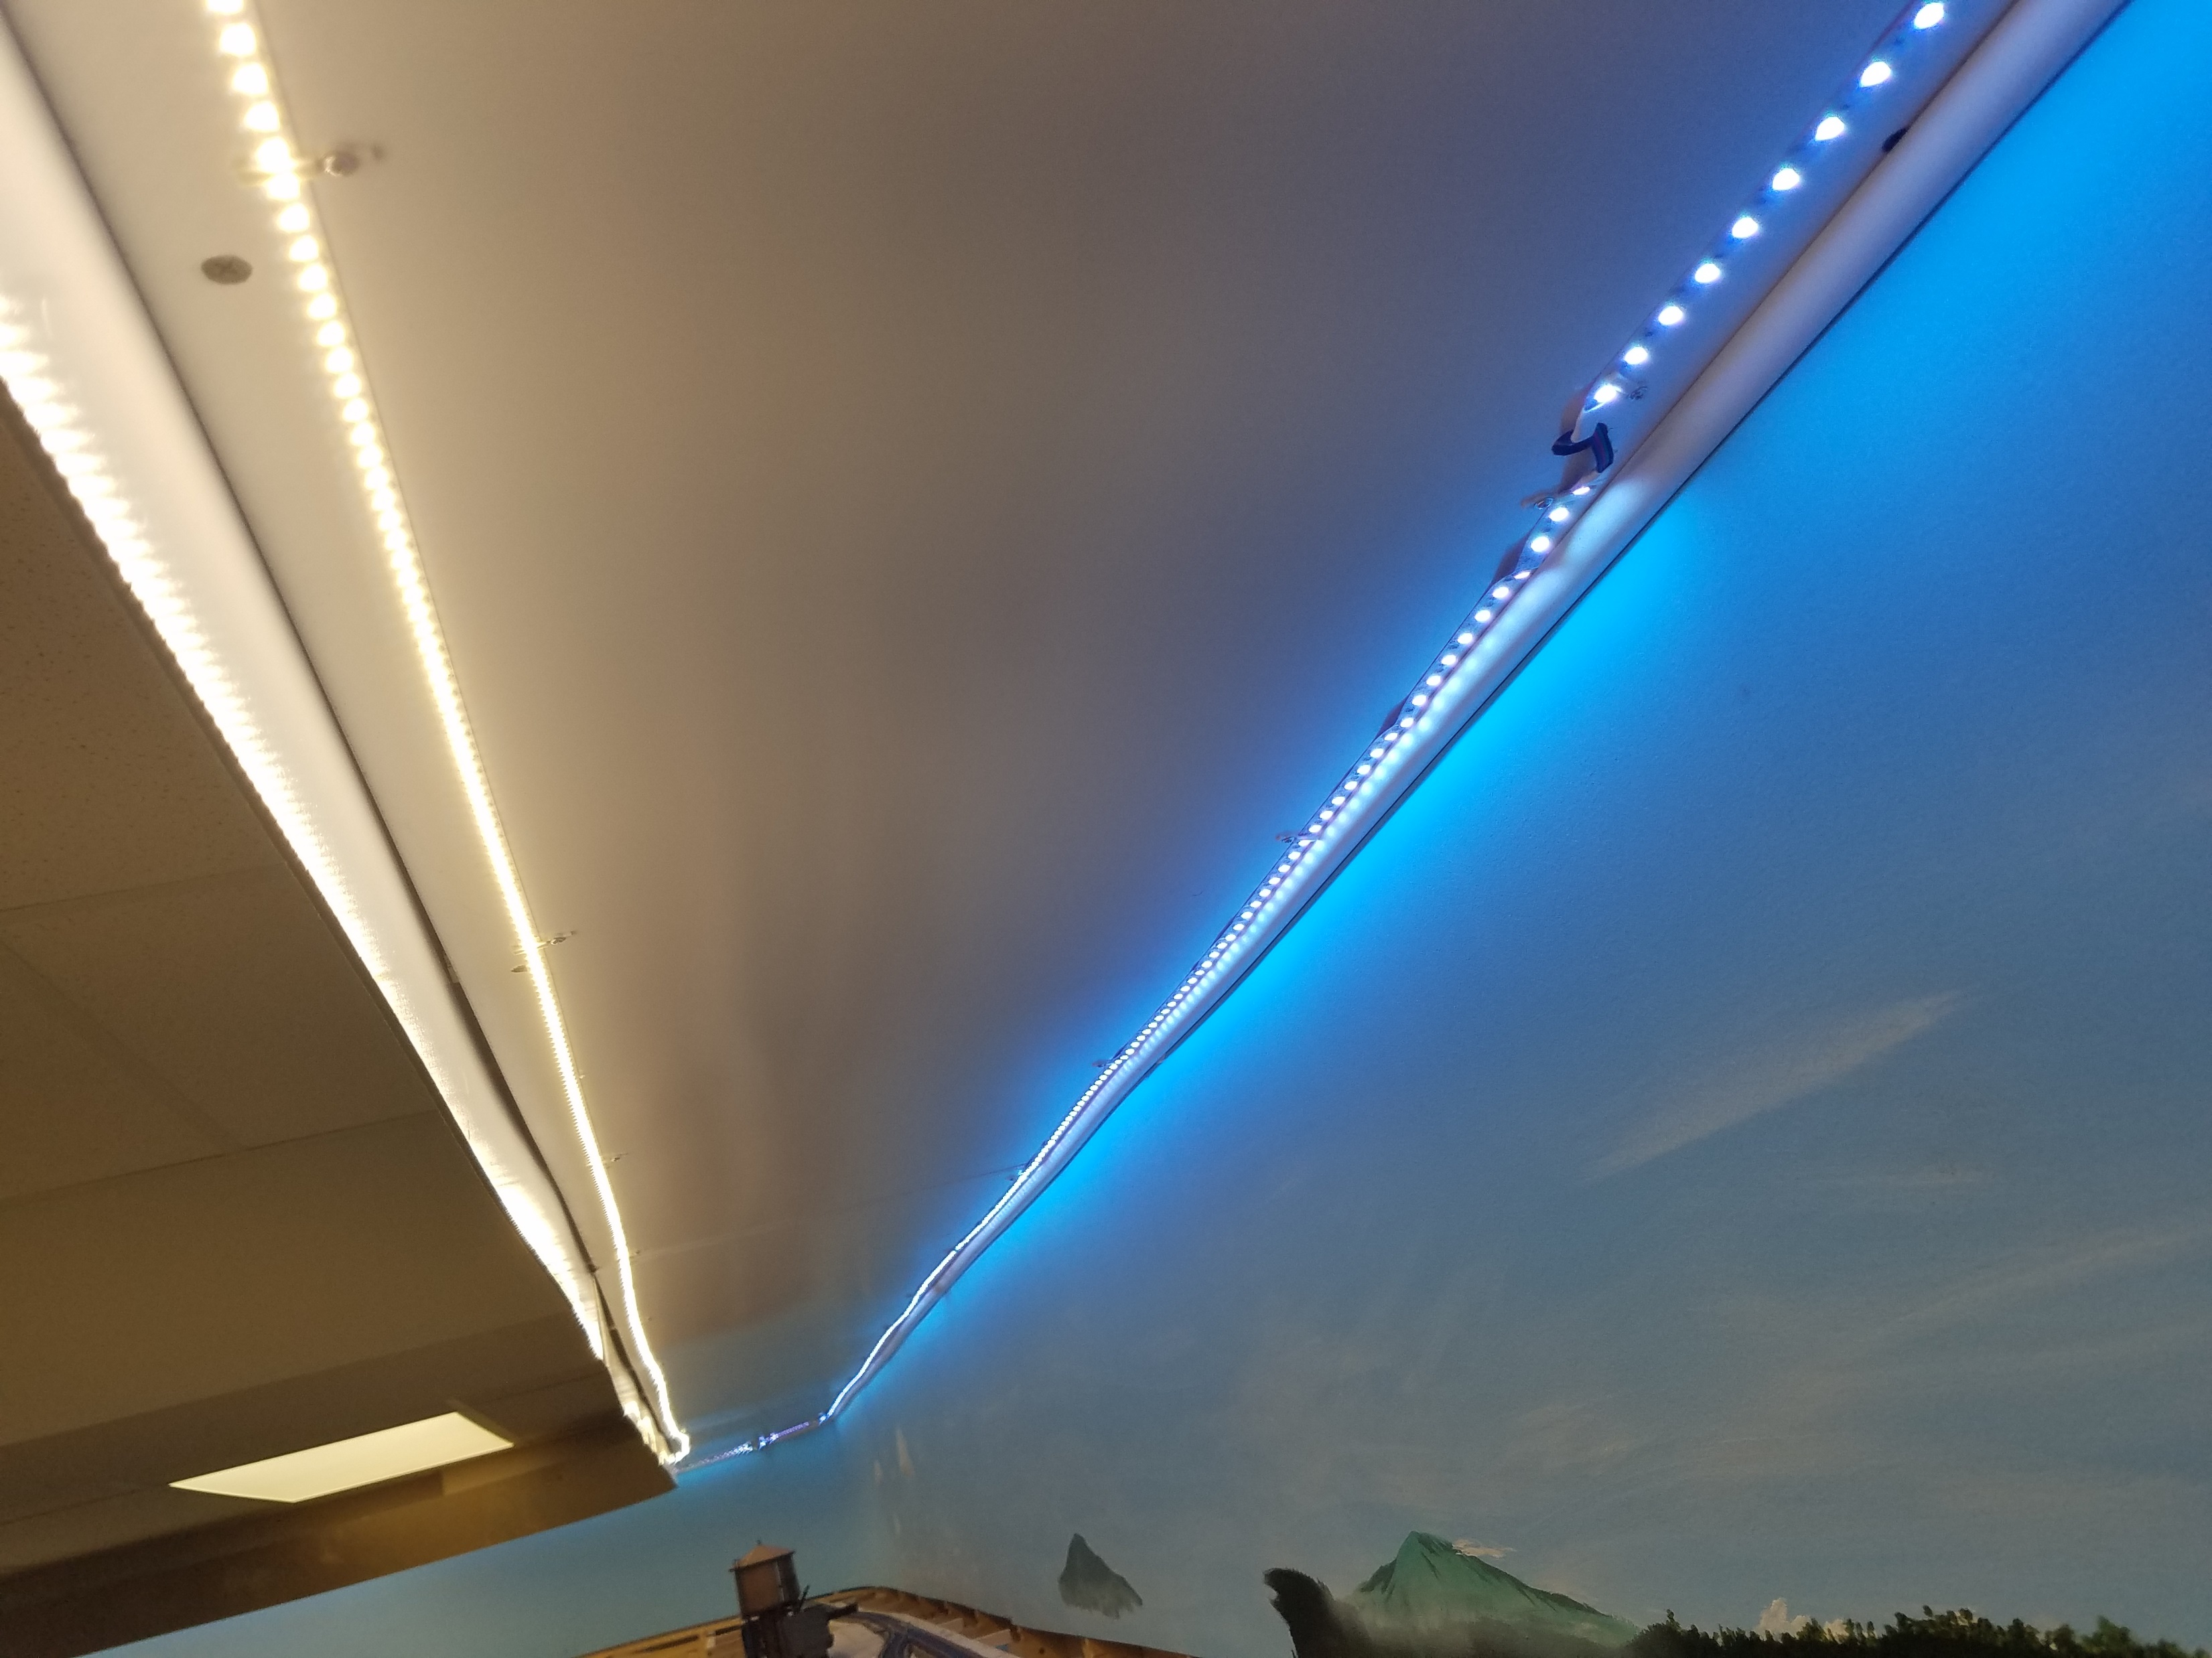
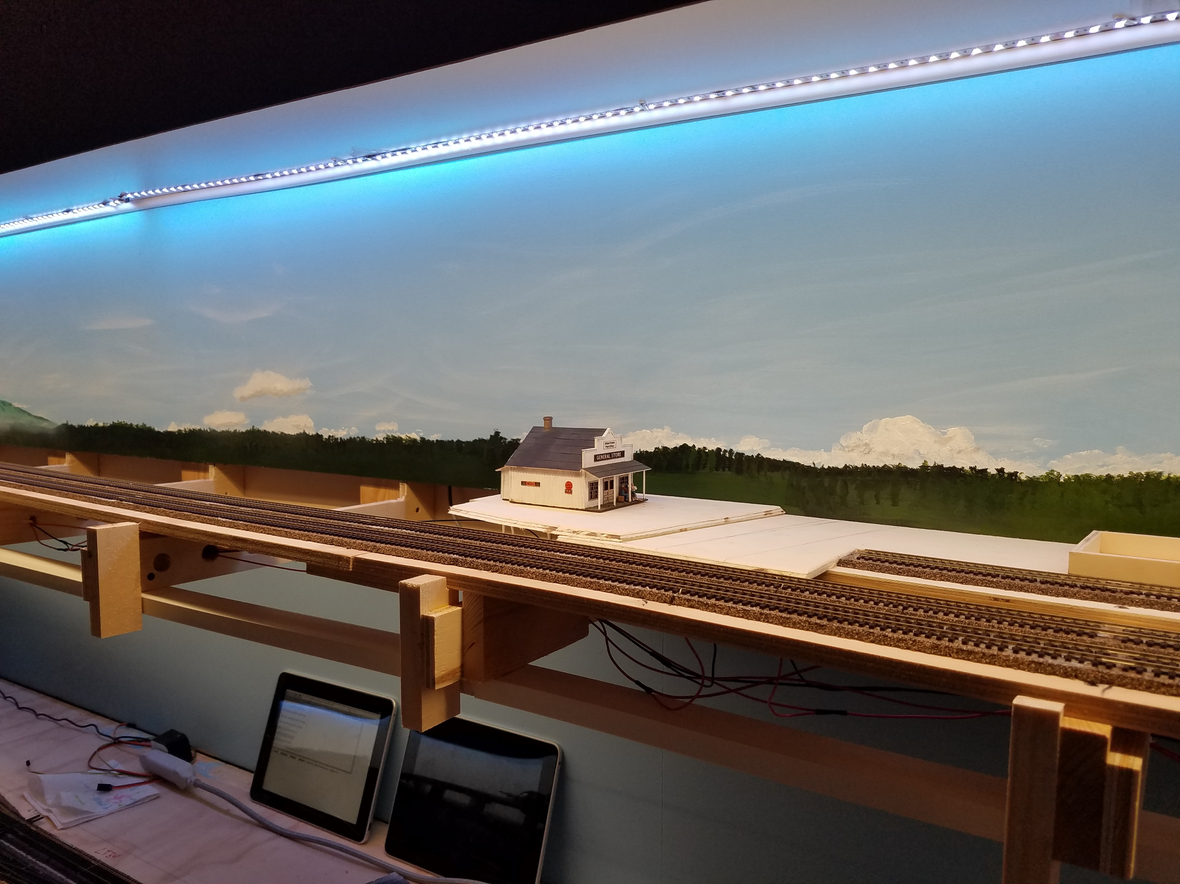
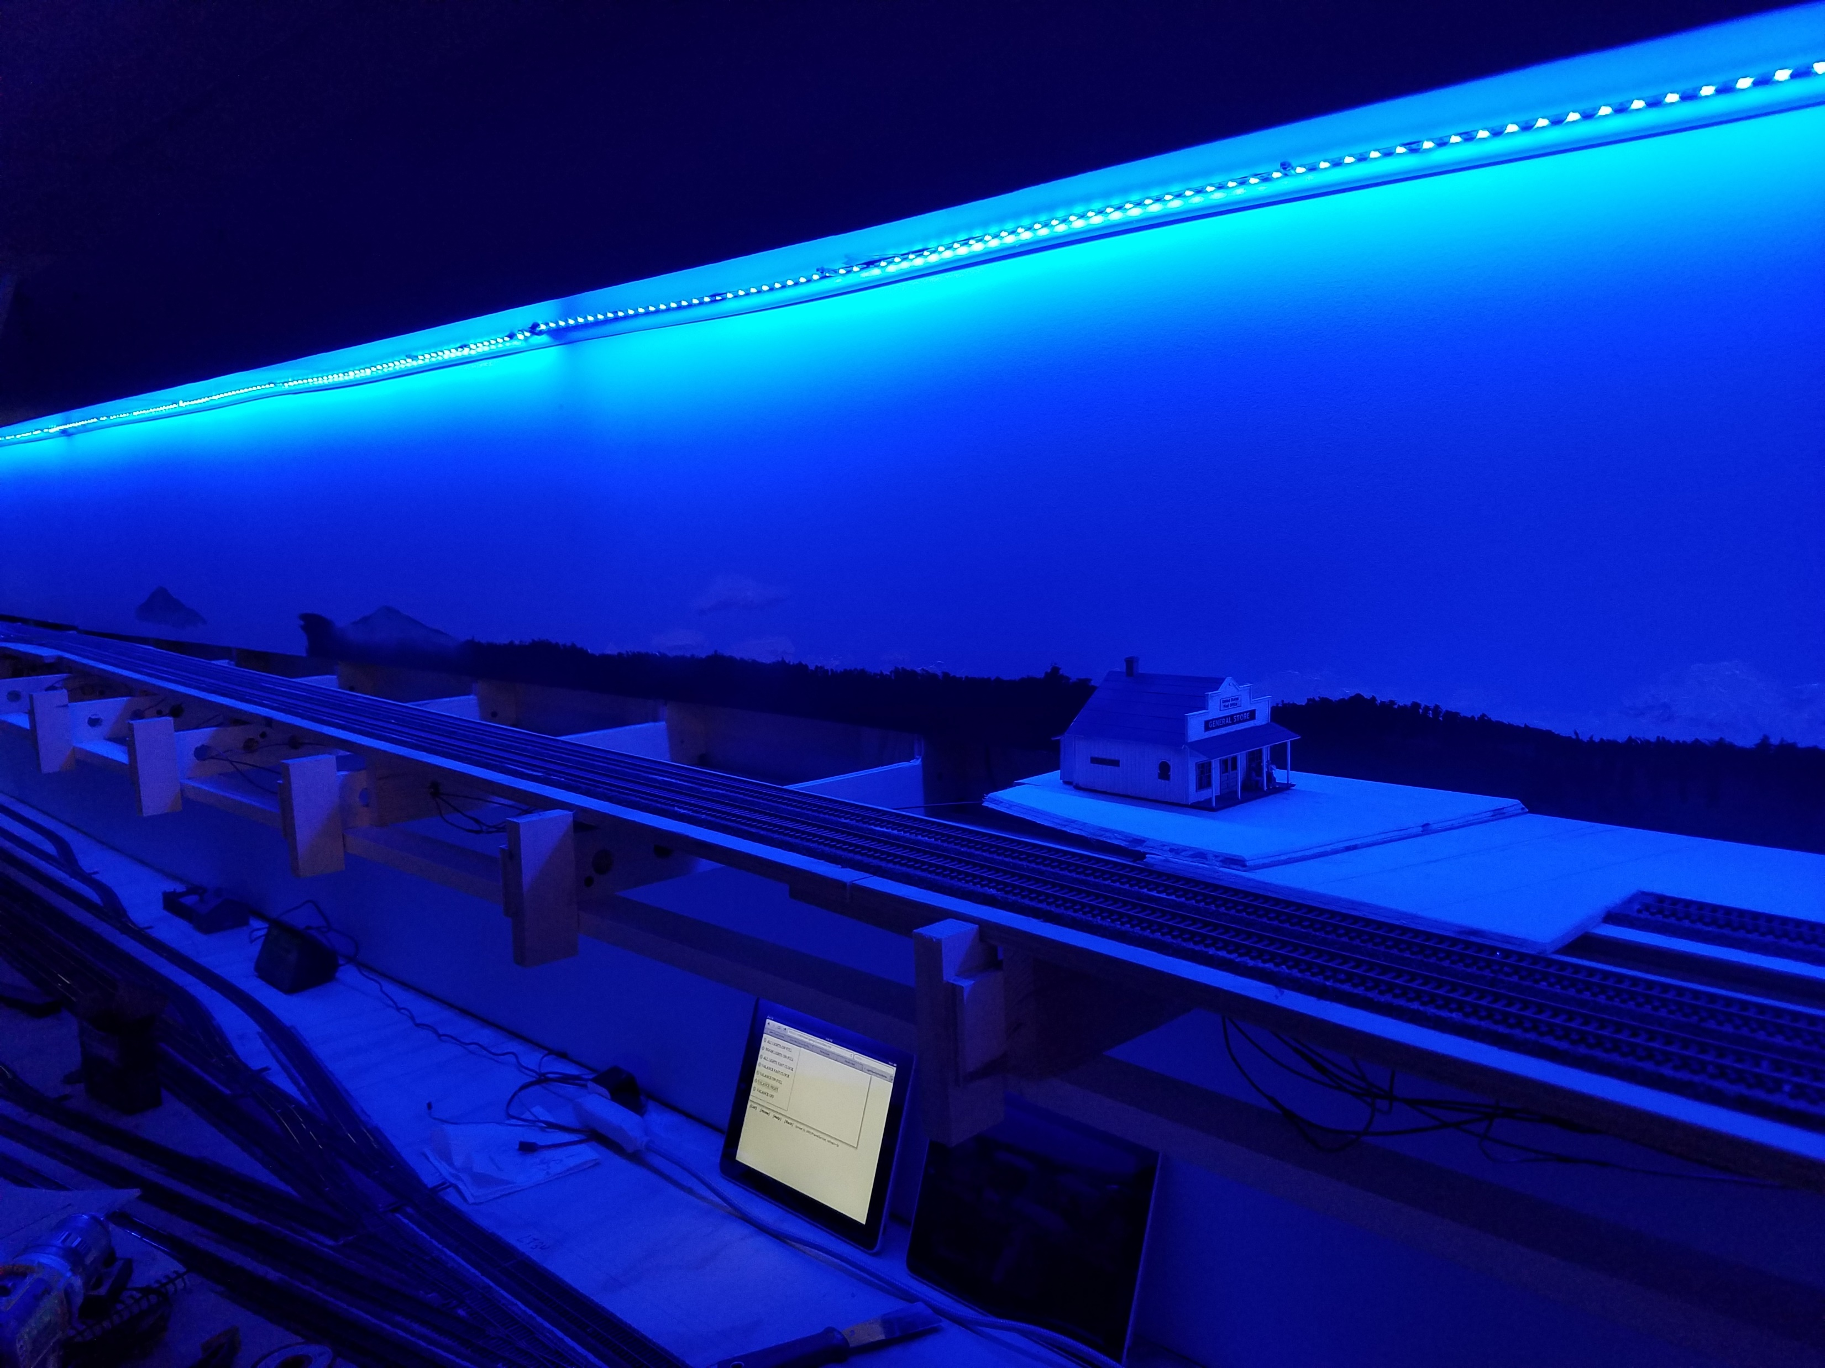

Slide 11
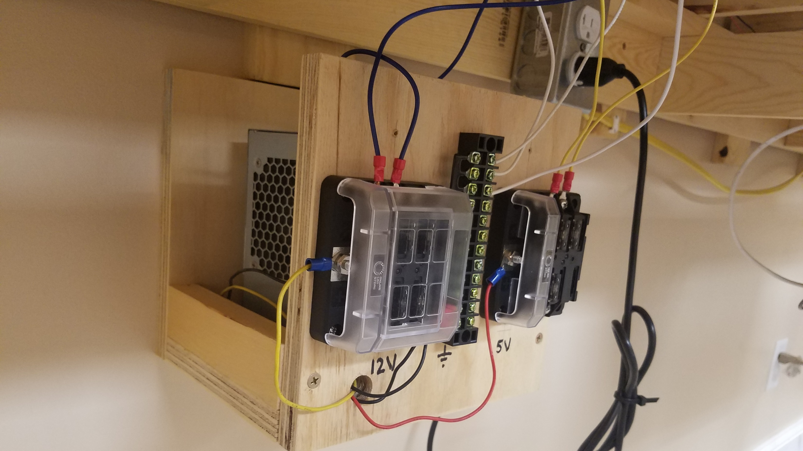

Slide 12
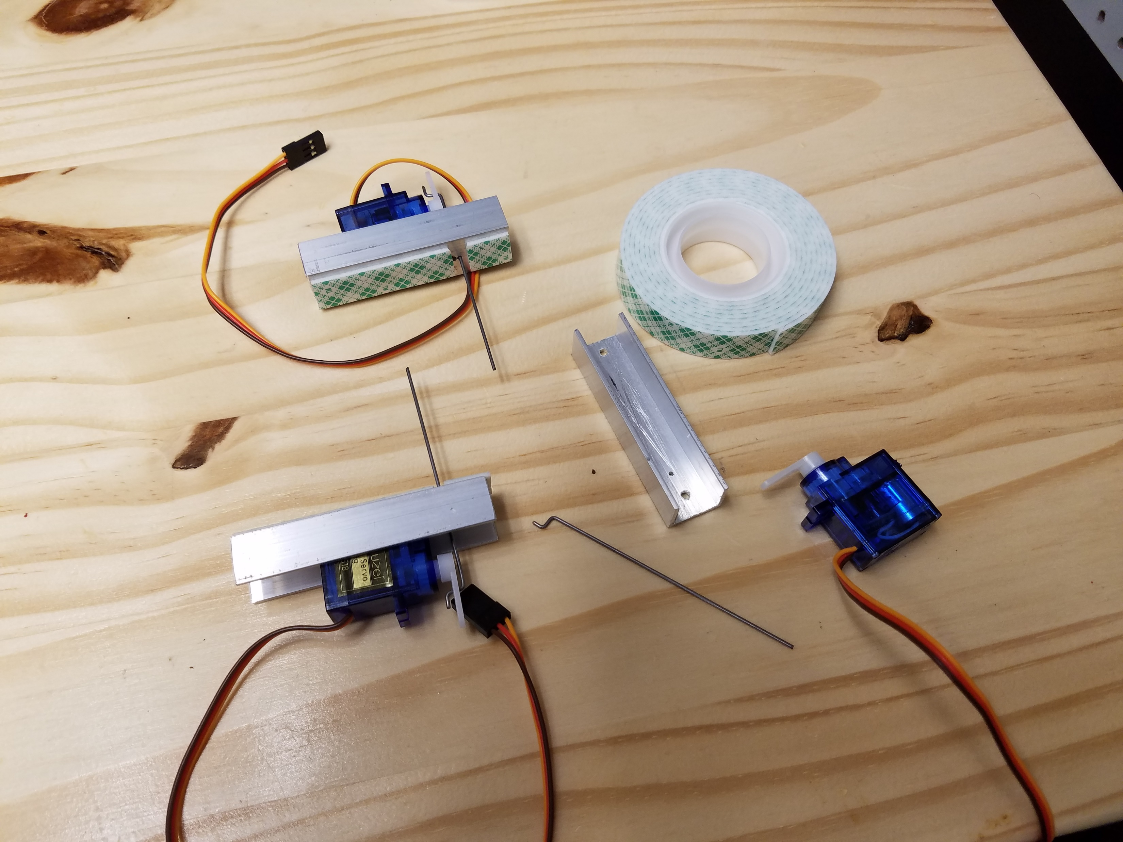
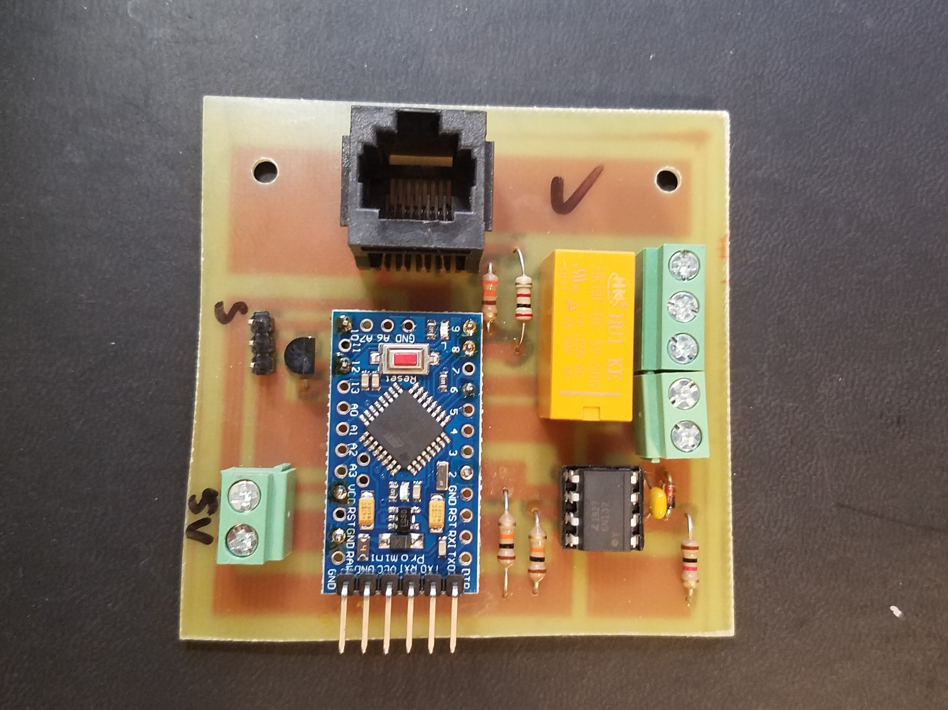
DCC Turnout Decoder
Servo Turnout Actuator

Slide 13



Slide 14
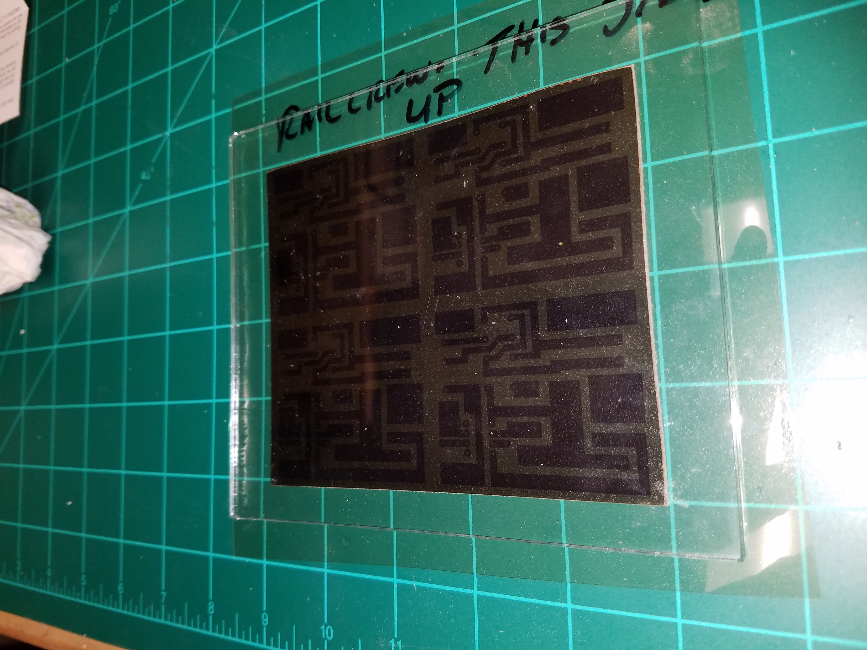
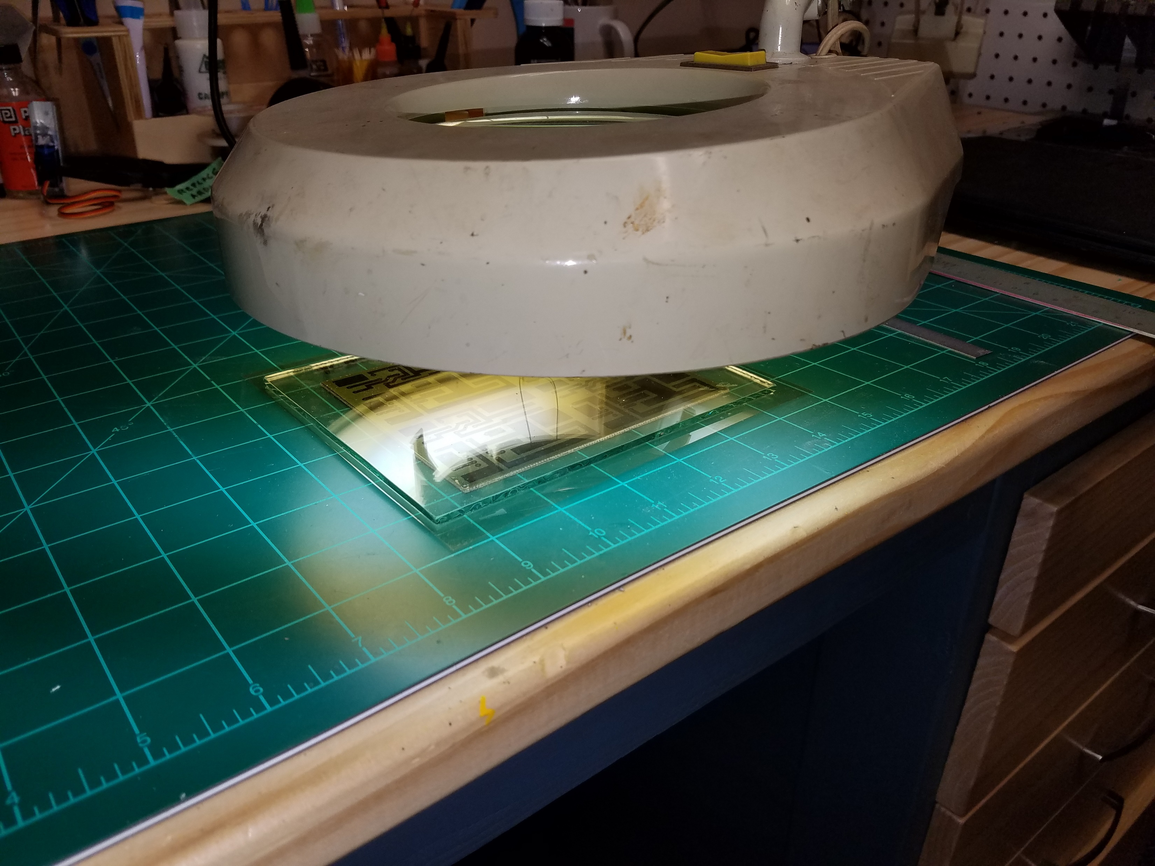

Slide 15
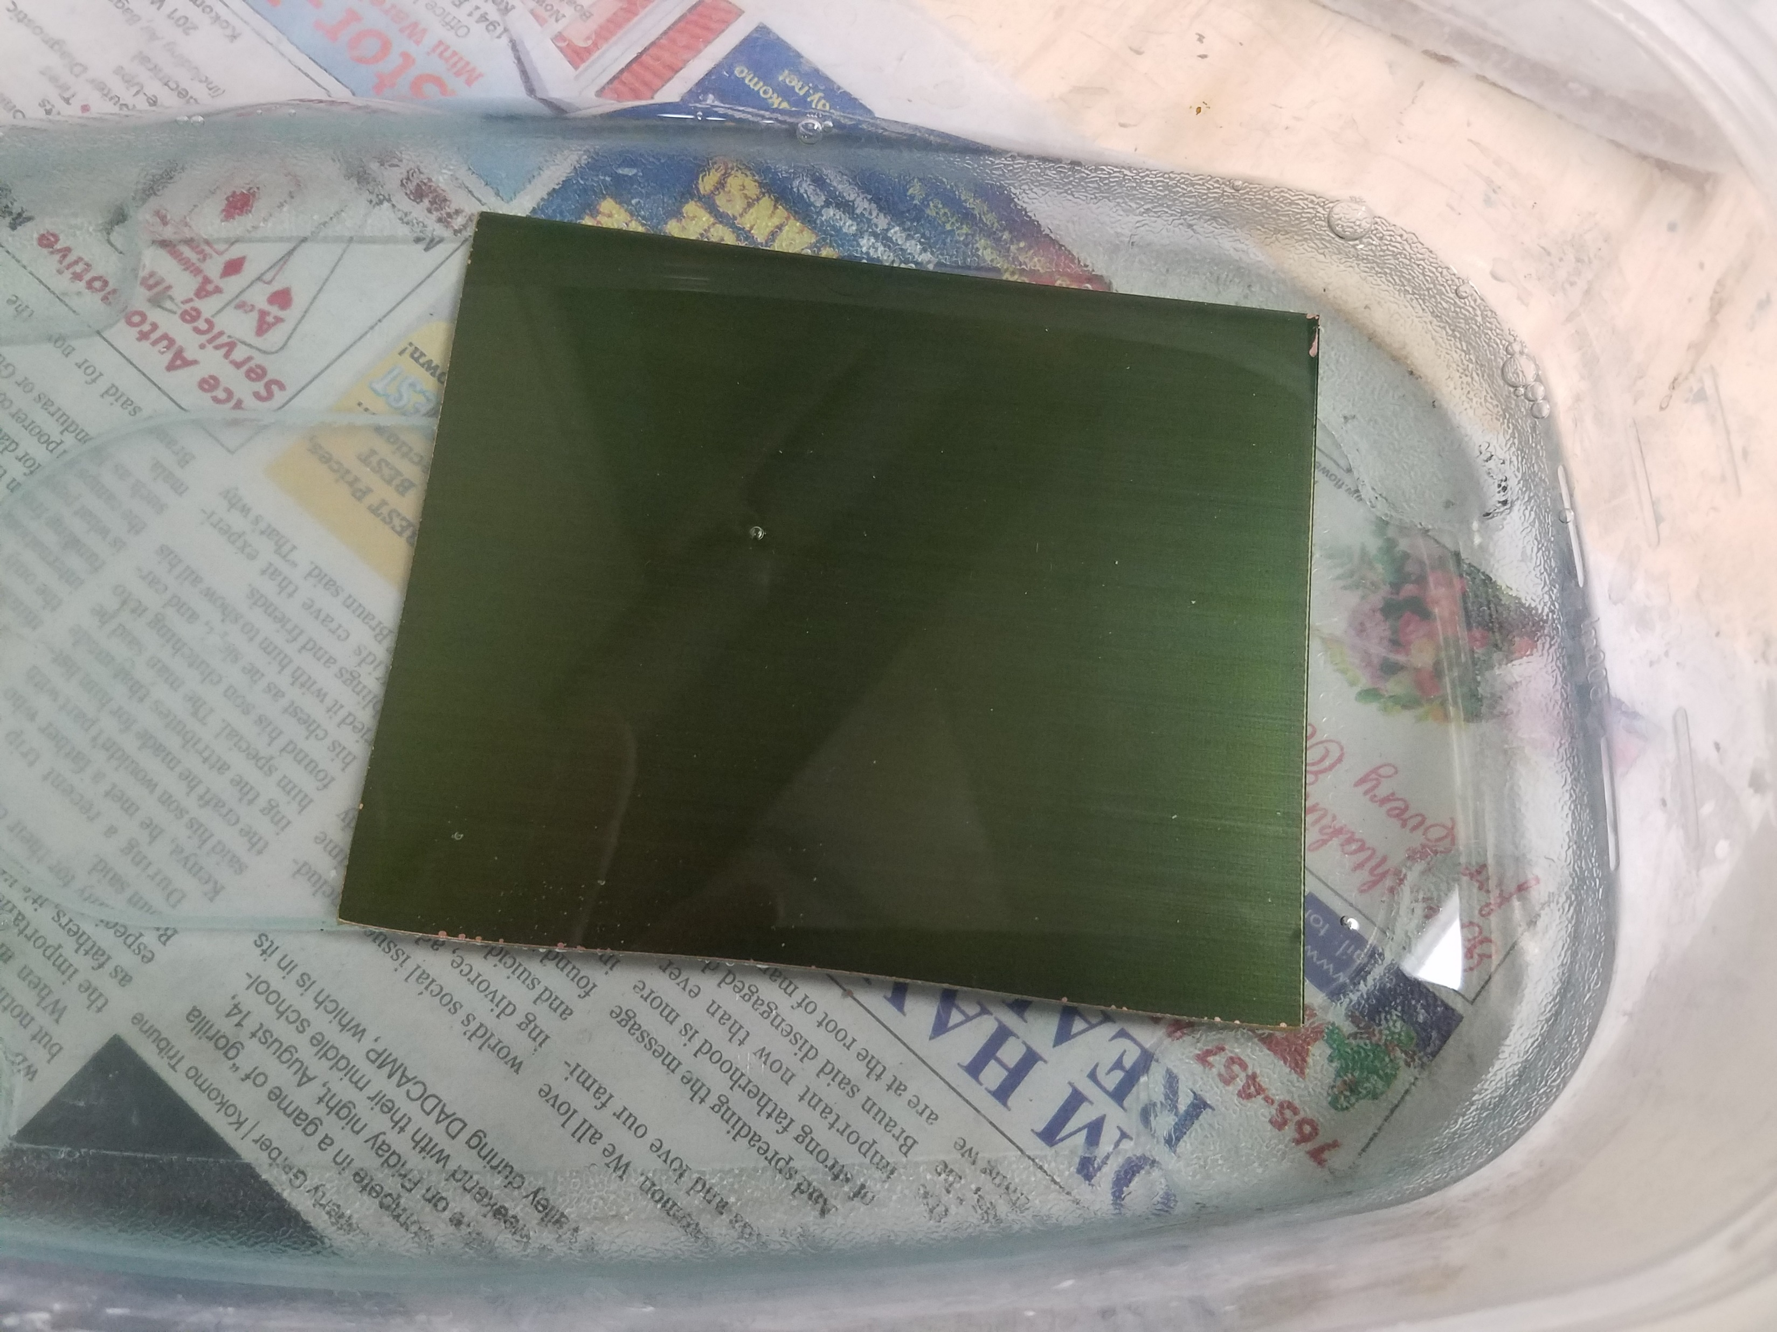
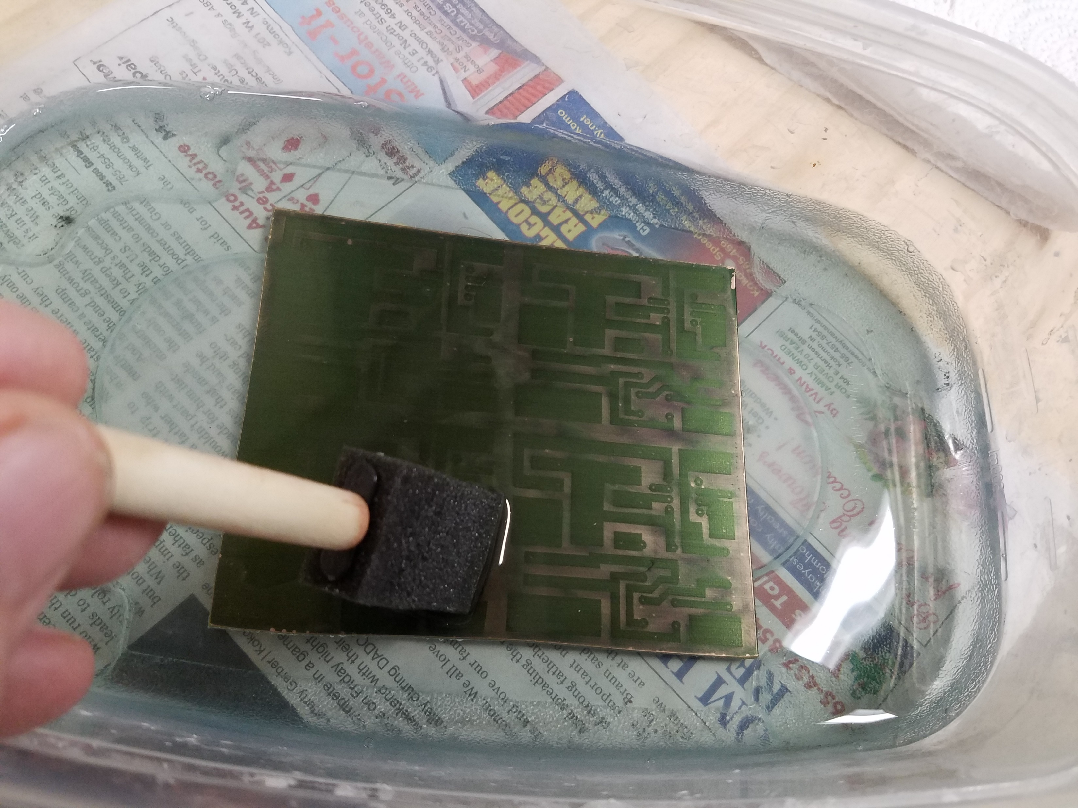

Slide 16
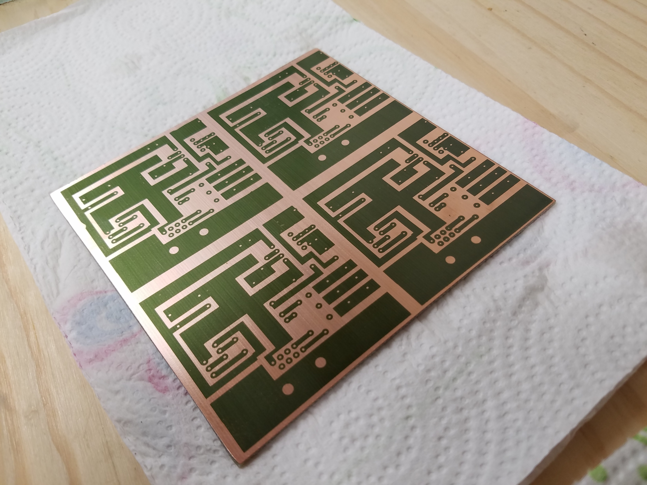

Slide 17
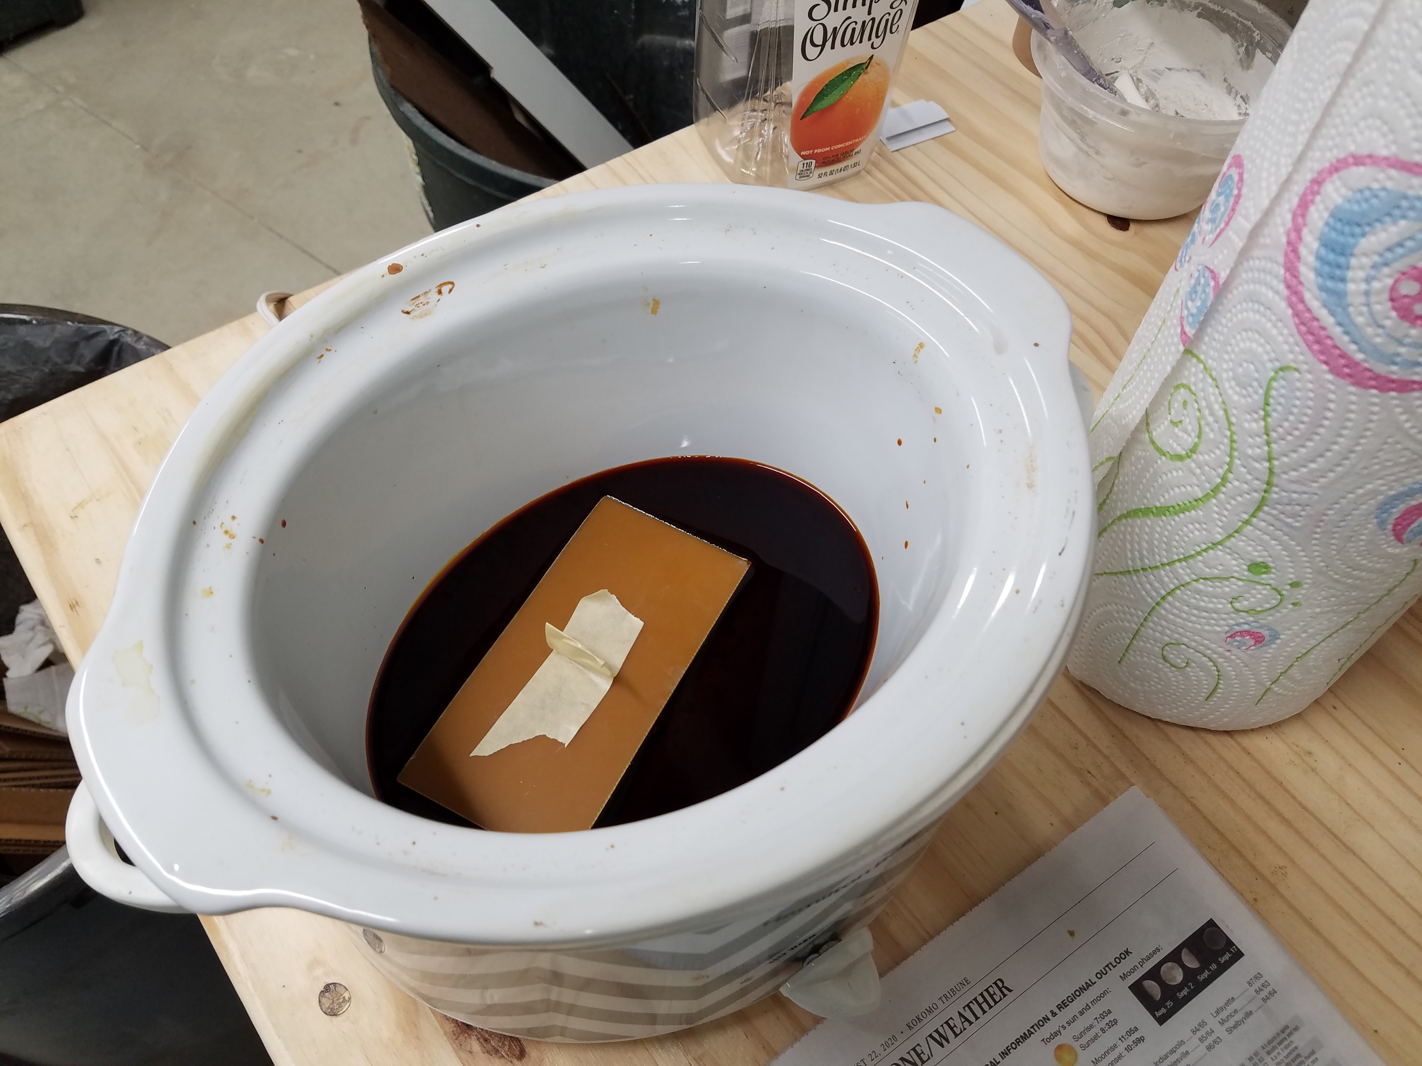
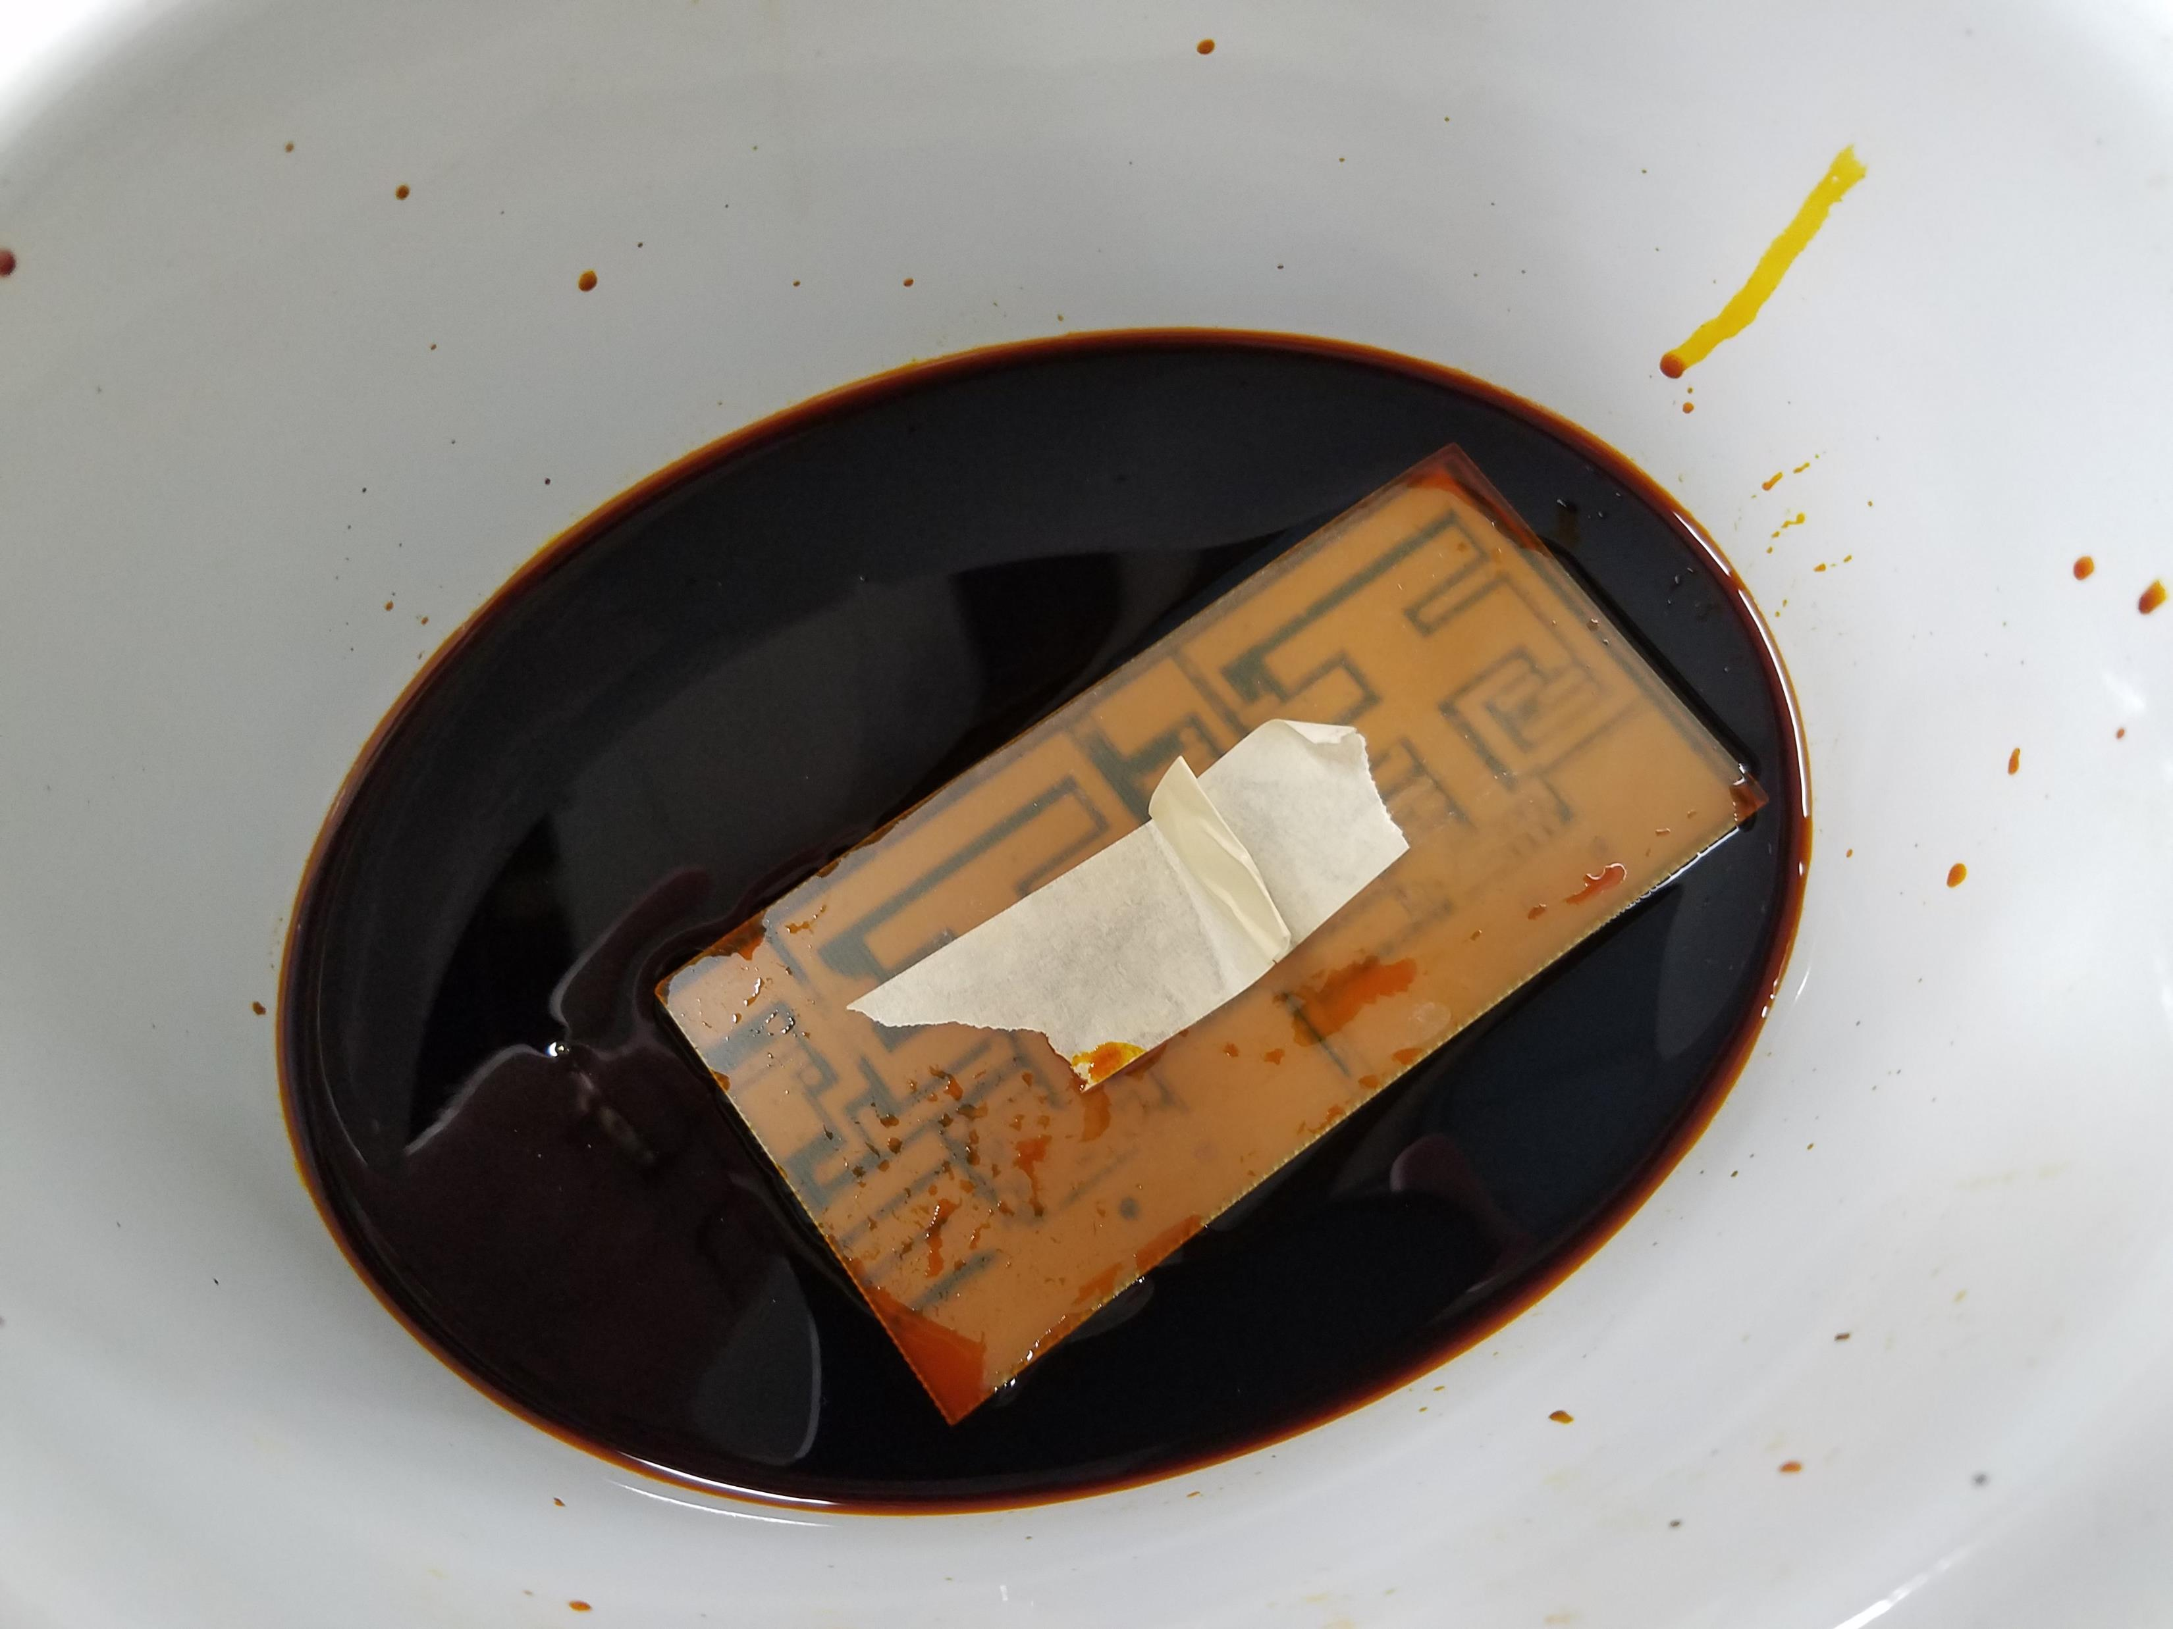

Slide 18
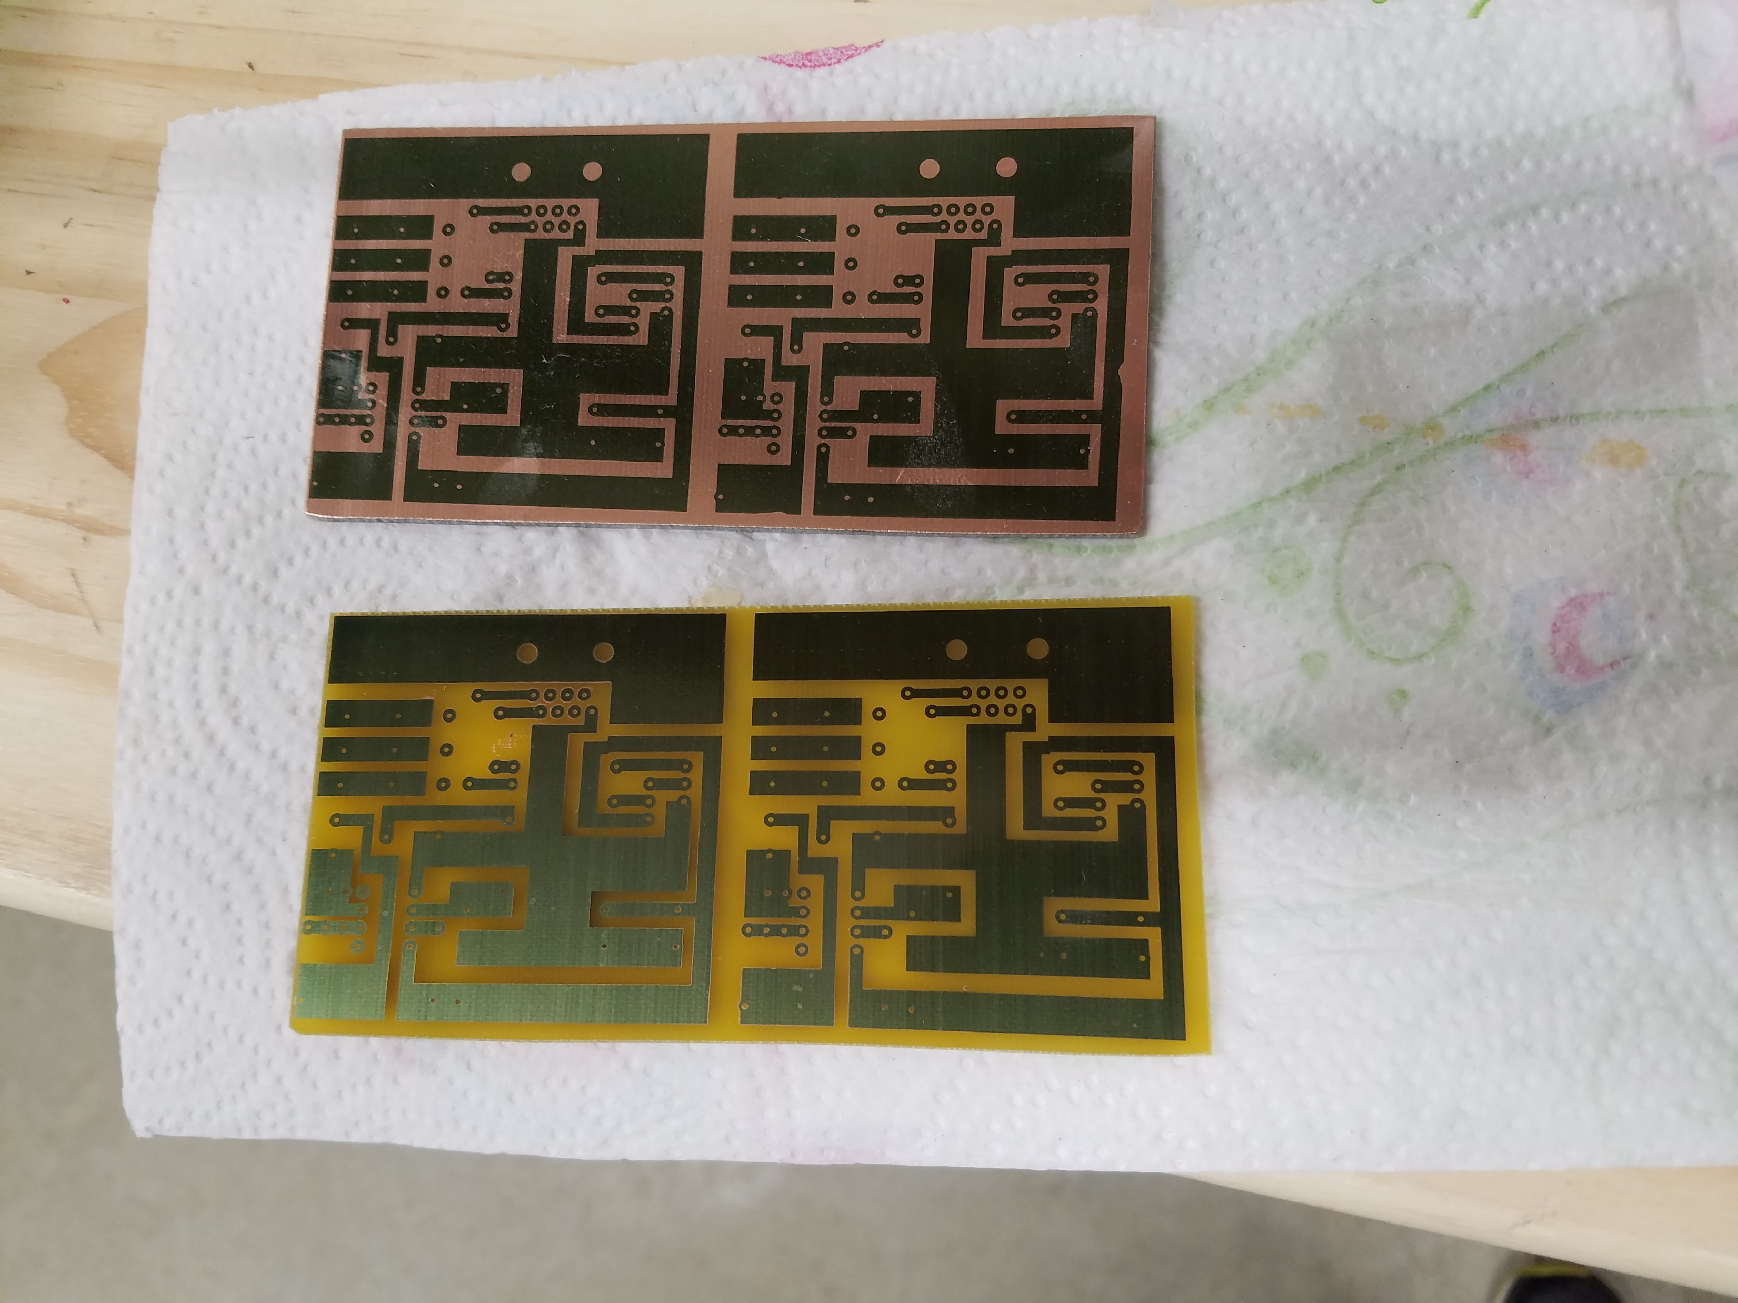

Slide 19
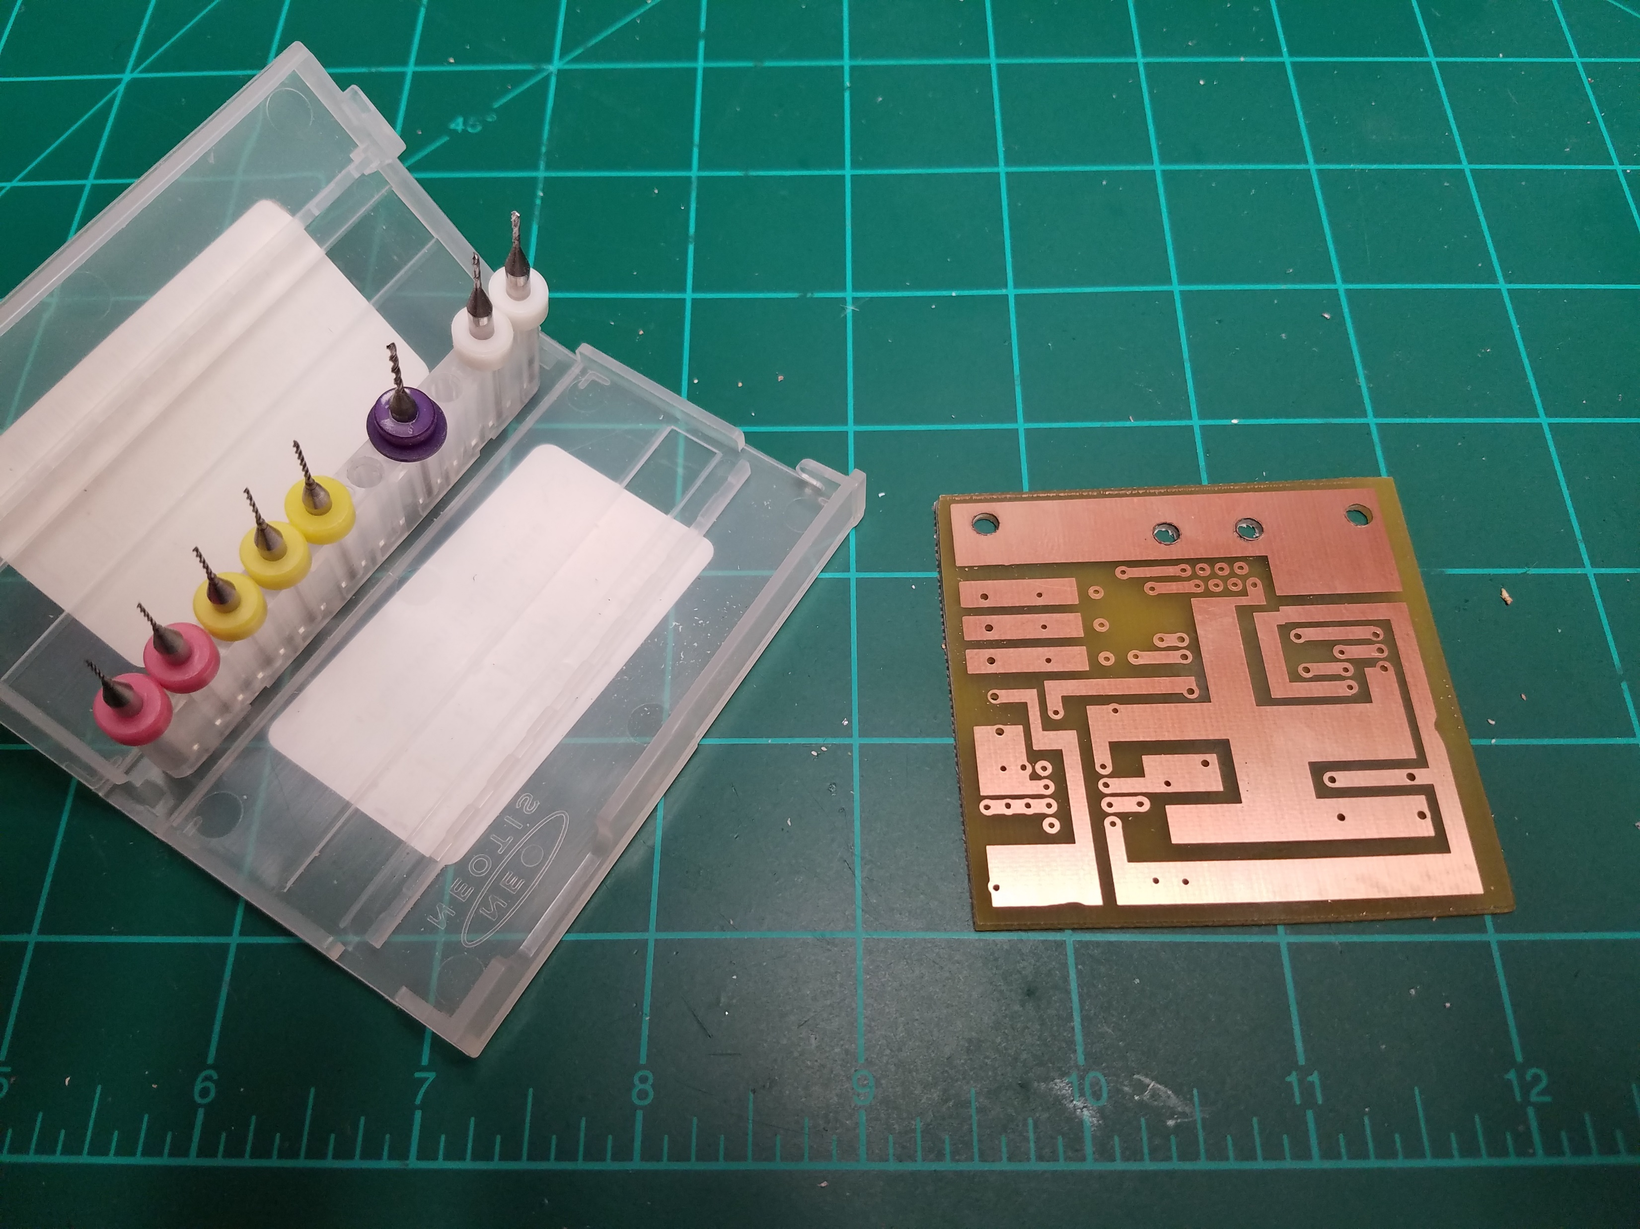

Slide 20
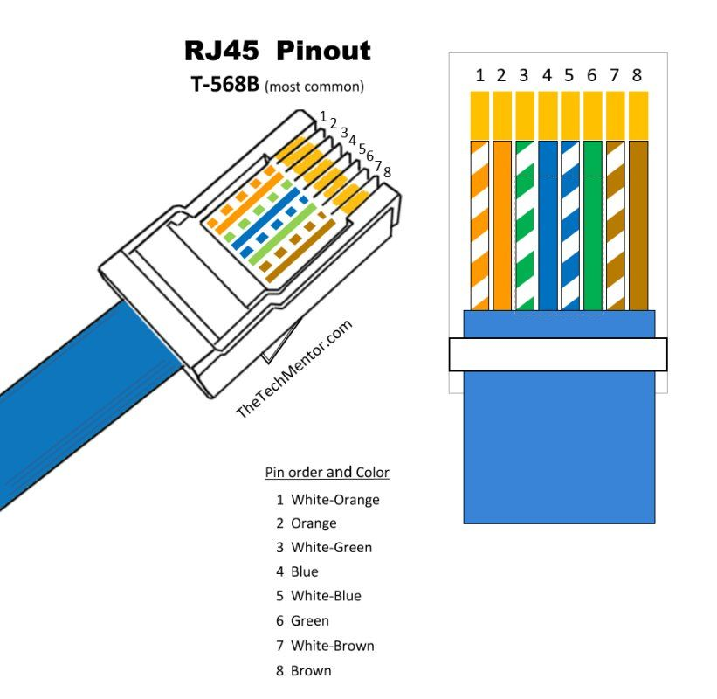
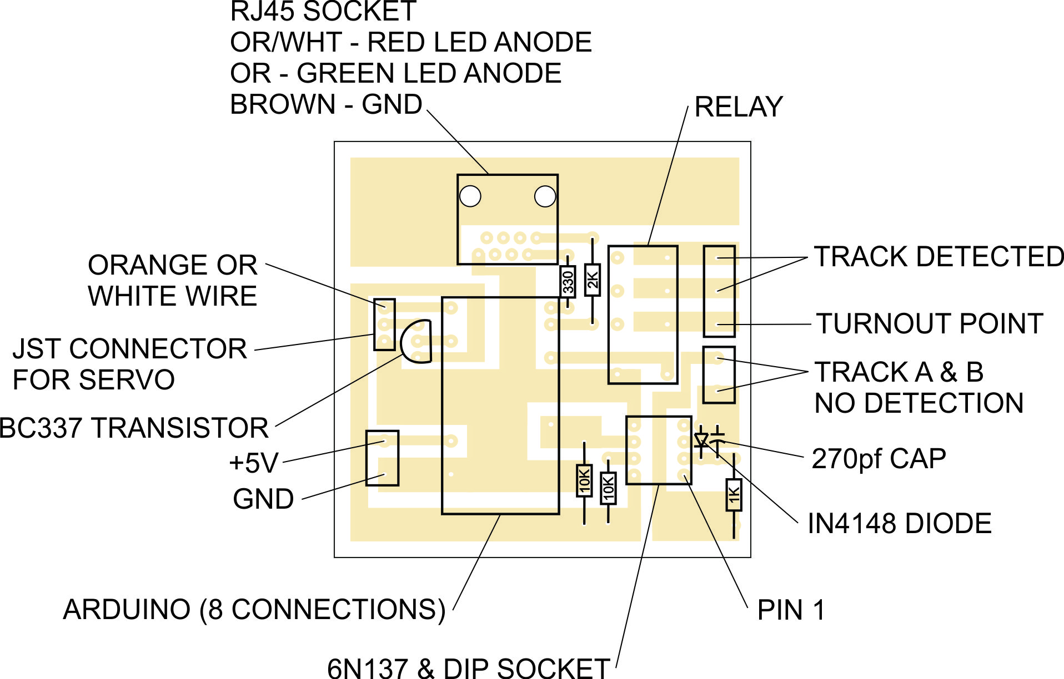
Arduino Connections
10
9
8
12
6
2
GND
VCC

Slide 21
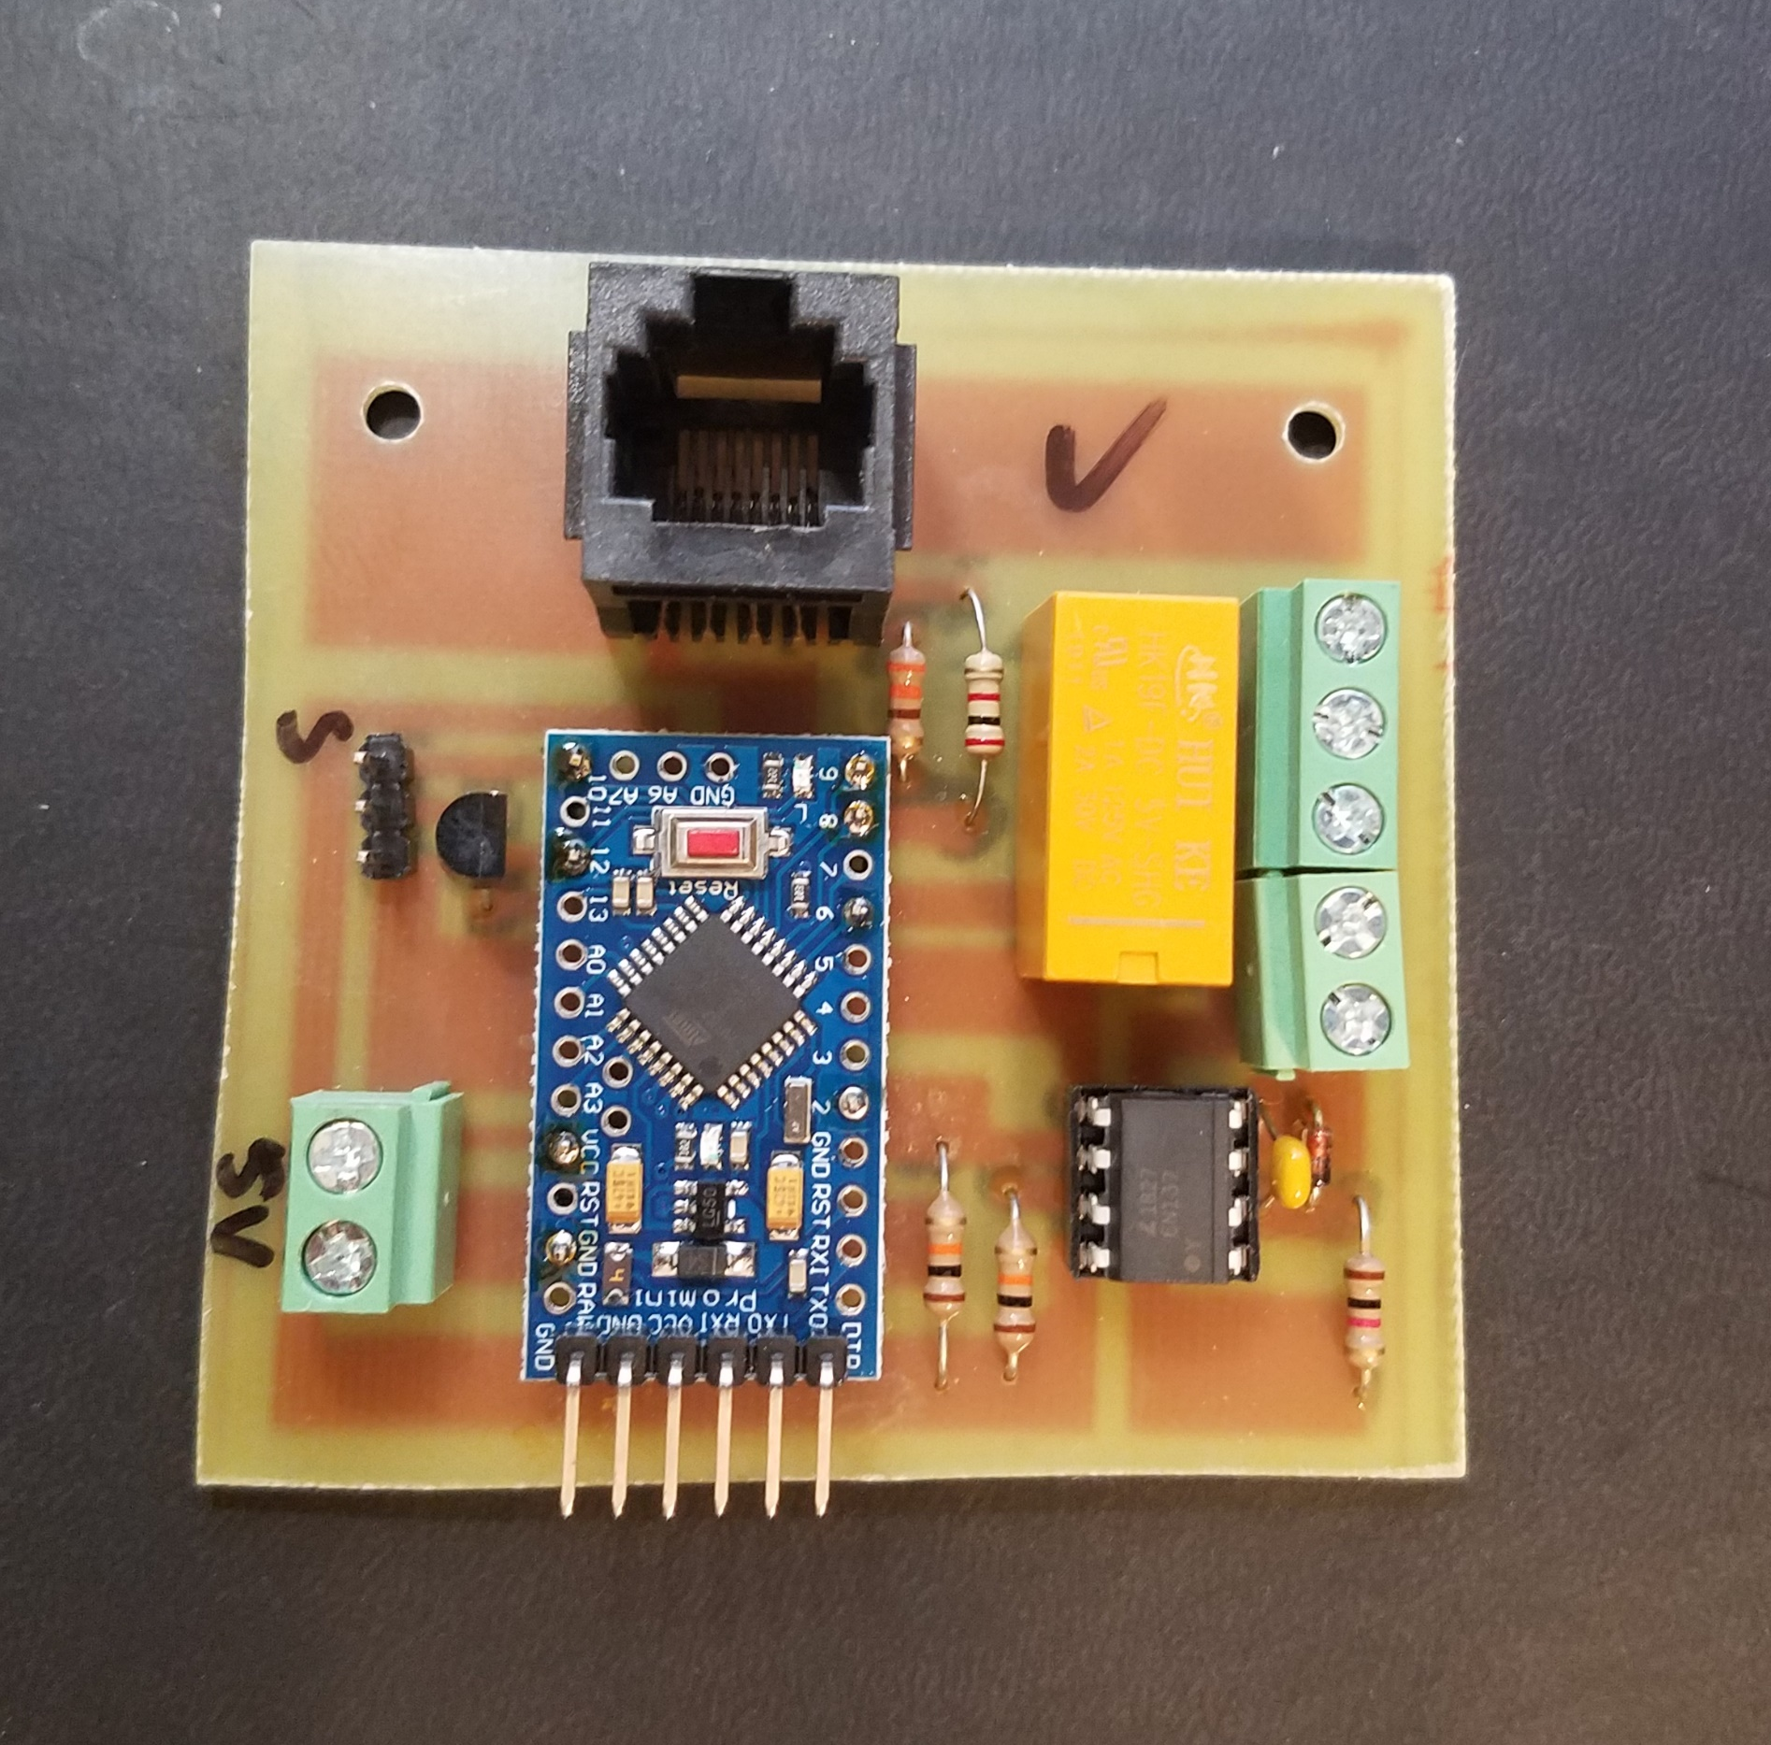

Slide 22
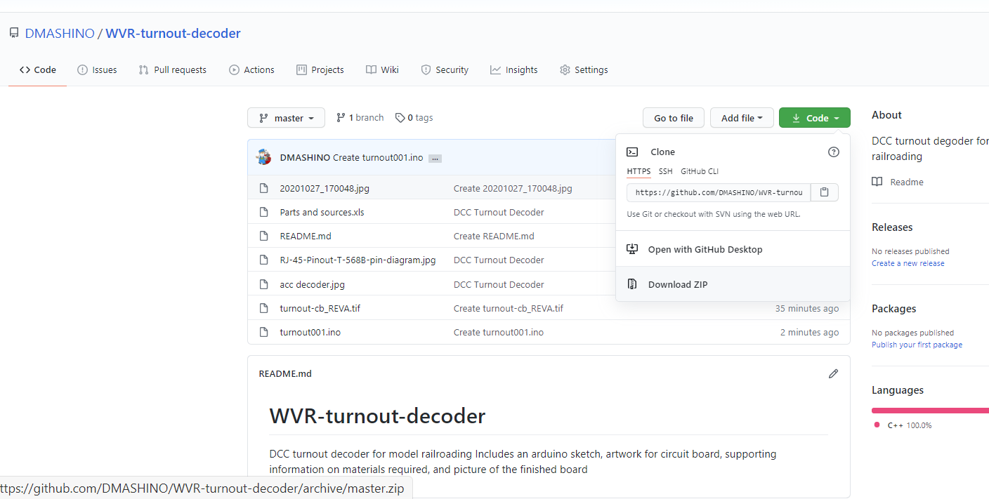
https://github.com/DMASHINO/WVR-turnout-decoder
To Download a .zip folder

Slide 23
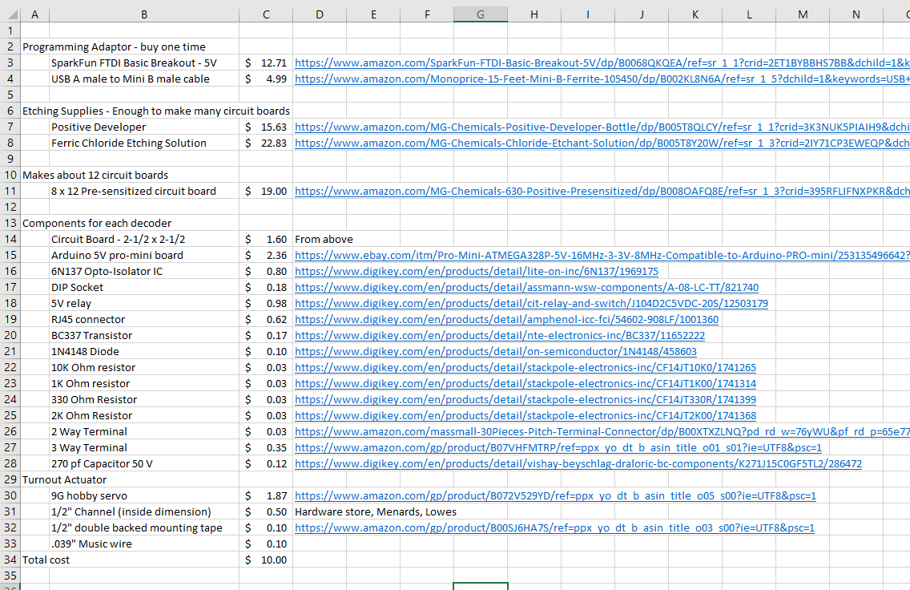

Slide 24
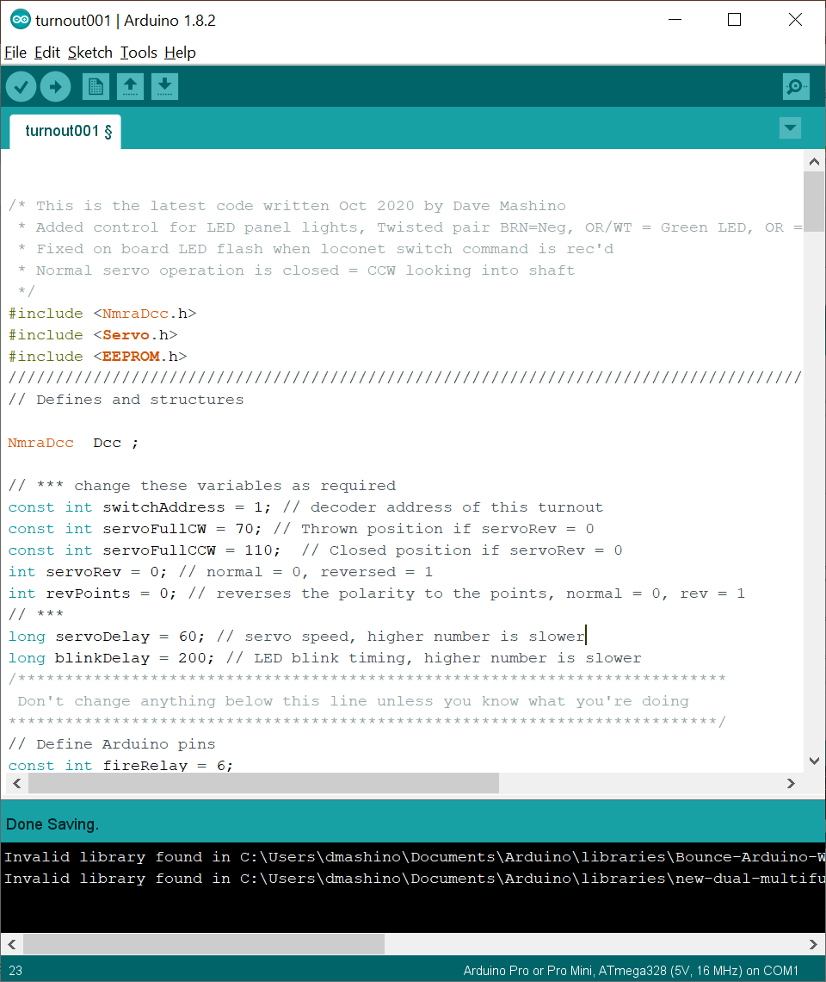
NmraDcc Library must be installed
Google “Arduino NMRADCC”

Slide 25
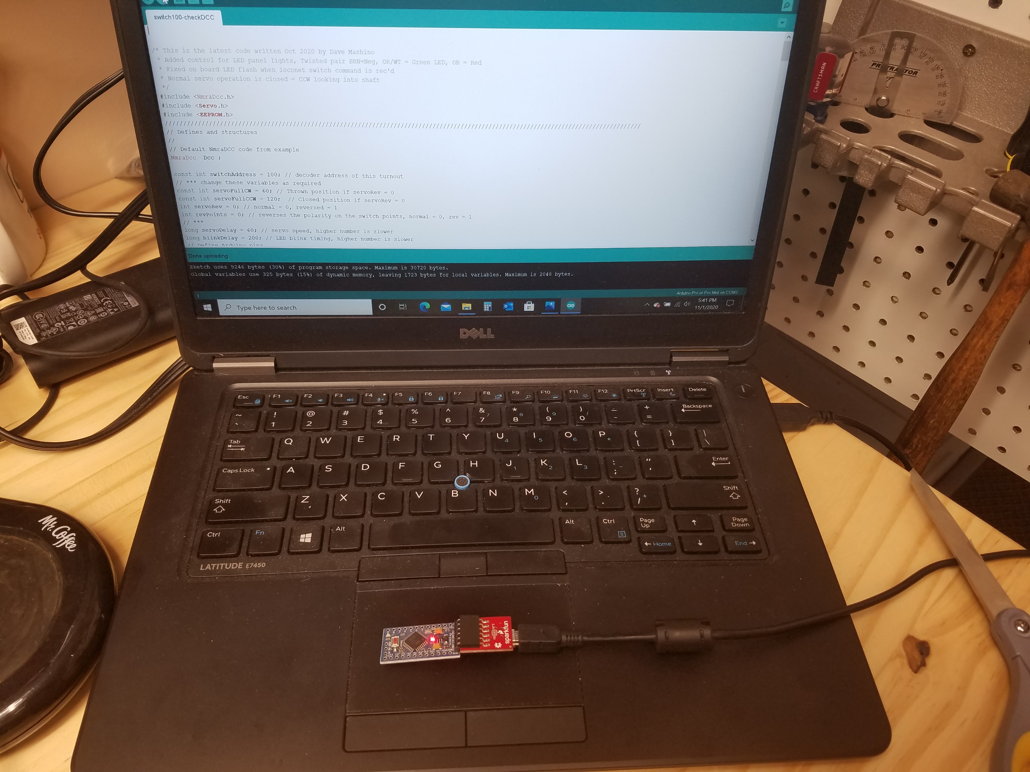
Upload the program to the Arduino using the FTDI breakout board and USB cable

Slide 26
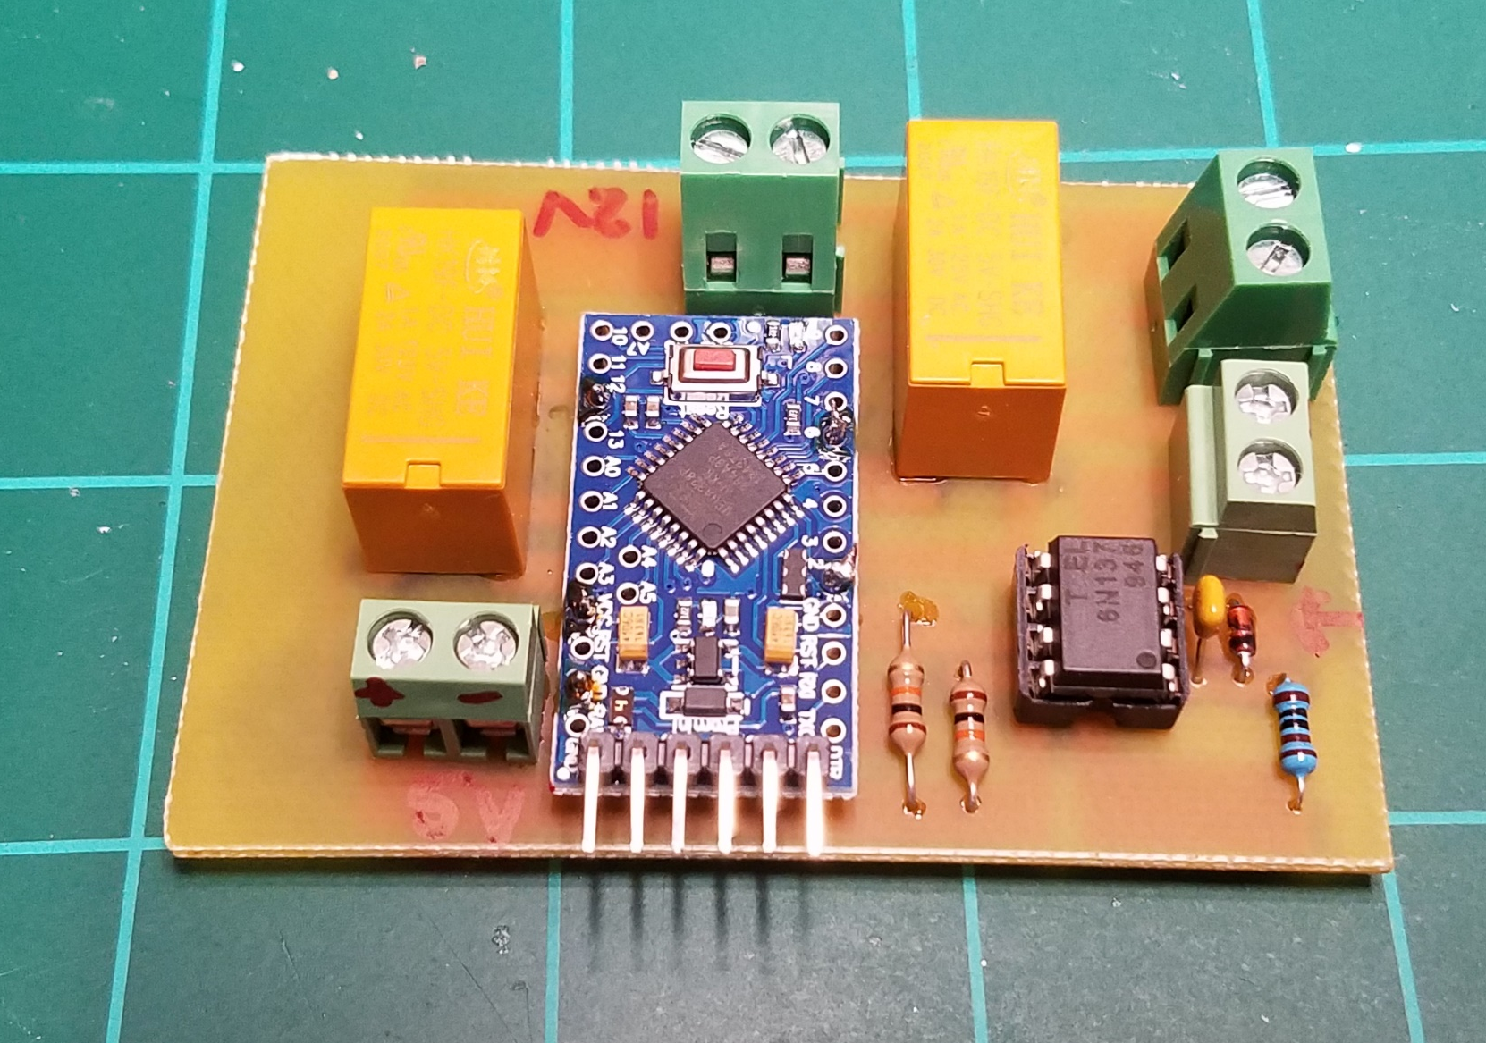
Two additional boards based on the simple DCC accessory decoder
Operates four single or double head semaphore signals with LED’s.
Control for a Rapido RailCrew uncoupler

Slide 27

Thanks!
Contact info: dave@mashinos.com

